Slide 1



Multilevel Regression
Part 2: Random intercept and random slope model
Ben Meuleman, Ph.D.
Swiss Center for Affective Sciences
Université de Genève
March 1–4, 2022

Slide 2
Contents
Traditional repeated measures models
  Standard linear model
  Non-independent data
  Challenges to classic approaches
Random intercept and random slope model
  Random intercept model
  Random slope model
Model selection and diagnostics for multilevel models
  Selection of random and fixed effects
  Model fit and effect sizes
  Problems and residual diagnostics
Hierarchical, trial-level, and longitudinal data
  Hierarchical data and post-hoc tests
  Crossed random effects and trial-level analysis
  Longitudinal data analysis
Miscellaneous topics in multilevel models

Slide 3
2. Random intercept and random slope model
A. Random intercept model

Slide 4
Let us backtrack for a moment
Obs. | Subject | Throw | Points
1 | Batman | T1 | 60
2 | Batman | T2 | 40
3 | Batman | T3 | 50
4 | Hulk | T1 | 1
5 | Hulk | T2 | 10
6 | Hulk | T3 | 25
7 | Spider-Man | T1 | 50
8 | Spider-Man | T2 | 15
9 | Spider-Man | T3 | 11
... | ... | ... | ...
60 | Iron Man | T3 | 19
Obs. | Subject | T1 | T2 | T3
1 | Batman | 60 | 40 | 50
2 | Hulk | 1 | 10 | 25
3 | Spider-Man | 50 | 15 | 11
... | ... | ... | ...
20 | Iron Man | 5 | 12 | 19
Wide format data
Long format data

Slide 5
Let us backtrack for a moment
ε | 1 | 2 | 3 | 4 | 5 | 6 | 7 | 8 | 9 | ... | N
1 | σ² | ? | ? | 0 | 0 | 0 | 0 | 0 | 0 | ... | 0
2 | ? | σ² | ? | 0 | 0 | 0 | 0 | 0 | 0 | ... | 0
3 | ? | ? | σ² | 0 | 0 | 0 | 0 | 0 | 0 | ... | 0
4 | 0 | 0 | 0 | σ² | ? | ? | 0 | 0 | 0 | ... | 0
5 | 0 | 0 | 0 | ? | σ² | ? | 0 | 0 | 0 | ... | 0
6 | 0 | 0 | 0 | ? | ? | σ² | 0 | 0 | 0 | ... | 0
7 | 0 | 0 | 0 | 0 | 0 | 0 | σ² | ? | ? | ... | 0
8 | 0 | 0 | 0 | 0 | 0 | 0 | ? | σ² | ? | ... | 0
9 | 0 | 0 | 0 | 0 | 0 | 0 | ? | ? | σ² | ... | ?
... | ... | ... | ... | ... | ... | ... | ... | ... | ... |  | ?
N | 0 | 0 | 0 | 0 | 0 | 0 | 0 | 0 | ? | ? | σ²

Slide 6
A different approach to non-independence
Refocus Question
Why are repeated measurements correlated?

Slide 7
Why are repeated measures correlated?
20 subjects complete a lexical decision task (word or non-word?) with affective priming. The prime word can be positive or negative, and the target word can be positive or negative. Researchers measure the reaction time (RT) to make the lexical decision on each trial.
Subjects typically react faster if the valence of prime and target match (on word trials).
However, subjects also differ individually in their decision speed. Slow subjects tend to react slowly in all conditions, and fast subjects tend to respond quickly in all conditions.
In other words, individual differences in “decision speed” potentially explain why reaction times within a subject are correlated…
Subject ID | Speed | Prime | Target | RT
ID1 | 1.21 | Positive | Positive | 502
ID1 | 1.21 | Positive | Negative | 553
ID1 | 1.21 | Negative | Positive | 549
ID1 | 1.21 | Negative | Negative | 511
ID2 | 0.94 | Positive | Positive | 555
ID2 | 0.94 | Positive | Negative | 560
ID2 | 0.94 | Negative | Positive | 592
ID2 | 0.94 | Negative | Negative | 549
… | … | … | … | …
ID20 | 1.06 | Positive | Positive | 510
ID20 | 1.06 | Positive | Negative | 571
ID20 | 1.06 | Negative | Positive | 582
ID20 | 1.06 | Negative | Negative | 546

Slide 8
Fixed subject intercept – Naïve approach
If we had a measure of each subject’s decision speed, we could add it to an ordinary regression model as a covariate, to account for the dependence among the repeated measures.
This approach is no different to how regression handles any fixed effect. For example, within-gender correlation of measurements can be handled by adding a gender effect to the model.
Unfortunately, (a) we rarely have the right individual difference measure that explains within-subject correlation, and (b) within-subjects correlation is often a result of multiple individual difference factors.
What if instead we just added “subject ID” as an effect to our model…?
RT ~ Prime*Target + Subject
Anova Table (Type II tests)
Response: RT
Sum Sq Df F value Pr(>F)
(Intercept) 1147546 1 564.8275 < 2.2e-16 ***
Prime 48191 1 23.7196 9.233e-06 ***
Target 7928 1 3.9021 0.05307 .
Subject 225781 19 5.8490 9.987e-08 ***
Prime:Target 36680 1 18.0541 8.034e-05 ***
Residuals 115806 57
--
E(RT) = β₀ + β₁ prime + β₂ target + β₃ (prime×target) + β₄ speed
What does it mean to have DF=19 and a significant effect for the subject variable…?

Slide 9
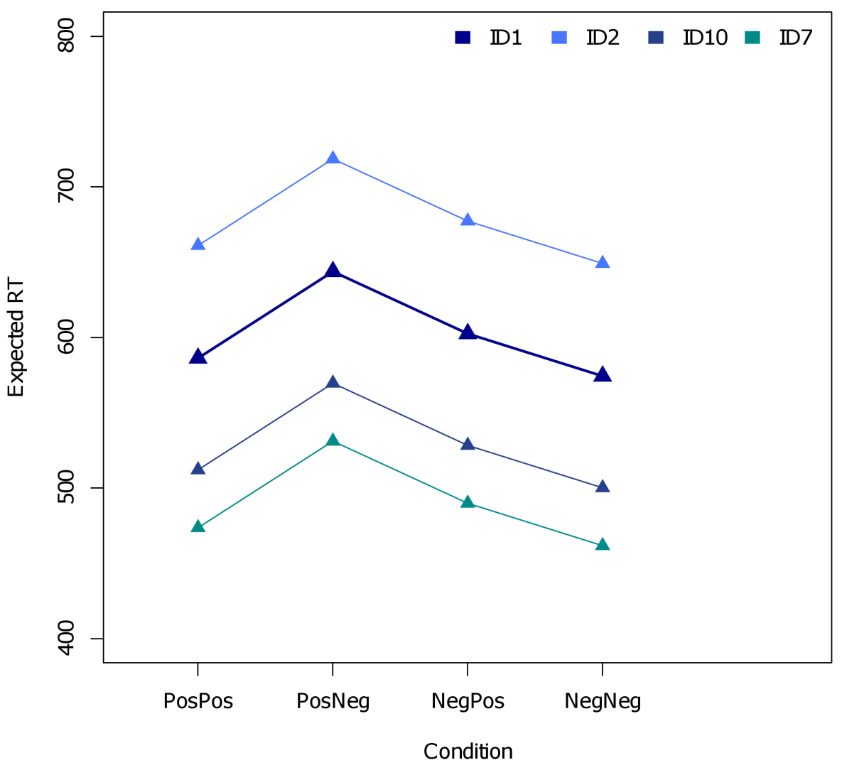
Fixed subject intercept – Naïve approach
RT profiles deviations from the reference subject
Adding a subject factor to our model with, e.g., 20 subjects, will add 19 dummy variables:
E(RT) = β₀ + β₁ prime + β₂ target + β₃ (prime×target)
+ β₄ subject₂ + β₅ subject₃ … + β₂₂subject₂₀
Each dummy coefficient codes the deviation in RT for that subject from the reference subject (here subject 1), in 0/1 fashion (=treatment coding).
When we also add the prime × target effects to the model, the subject effect codes an overall RT deviation in the prime × target RT profile, from the reference subject.
In other words, the subject effect allows each subject to have a constant/baseline deviation in RT
β₄
β₉

Slide 10
Fixed subject intercept – Naïve approach
Technically speaking, there is nothing wrong with the fixed intercept approach. However, there are many good reasons why it is actually undesirable:
  Parameter inflation and power: Adding a fixed subject effect to the model adds N–1 dummy variables (for N subjects). As a consequence, the degrees of freedom for any individual inferential test will be greatly reduced as compared to a model without the subject dummies.
  Interpretation: When using treatment coding for the individual subjects (0/1), the model no longer has a population-level profile for the RT conditions, and always needs to be conditioned on a particular subject for interpretation. As well, do we really have an interest in comparing pairs of subjects explicitly…?
  Simplification: A categorical subject effect only allows that subjects differ in their RT profile by a constant value, but it still forces the condition differences to be the same. For some subjects this may not be true!
  Generalization: Subjects are typically a random sample from a population of subjects. Treating subjects as fixed, however, pretends that the sampled subjects are the population. Any statistical inference will be valid only for this particular sample of subjects.

Slide 11
Random versus fixed sources of variation
Many variables influence a study without being an explicit part of the design, e.g.:
  A random group of subjects that was sampled for the study
  A random set of stimuli that was sampled for the study (e.g., photos from IAPS)
  Hour, day, or season when the study took place
  Country, city, or even the lab in which the study took place
These examples contribute random variation to measurement: With a different sample of subjects we will have slightly different measurements. This is opposed to manipulations (e.g., conditions), or controlling covariates (e.g., age), whose levels are typically fixed and therefore contribute fixed variation to measurement.
The levels of random variables typically represent a random sample from a population of their levels, e.g., a population of subjects, or a population of stimuli. Just as we want the results of our analysis to generalize to the population of subjects, we want to generalize to the population of stimuli, times, days, or countries.
Multilevel linear regression achieves this by treating these variables explicitly as random. As such, the model is a hierarchical approach to modelling repeated measures covariance.

Slide 12
Random intercept model
The simplest type of hierarchical regression is the so-called random intercept model. Here, I illustrate the model for simple one-way regression:
Y_{ij} = β₀ + β₁X_{ij} + b_{i} + ε_{ij}
Y_{ij} A measured response/dependent for the i^{th} subject for the j^{th} repeat
X_{ij} A fixed predictor/independent with values for the i^{th} subject for the j^{th} repeat
β₀ The population intercept. The baseline response, across subjects, when X_{ij} = 0
β₁ The population slope. The rate of change between X and Y, across subjects
b_{i} A between-subject intercept. A constant deviation of the population intercept
for the i^{th} subject
ε_{ij} A within-subject error. A constant deviation of the population response
for the i^{th} subject for the j^{th} repeat

Slide 13

Random intercept model
Both the subject intercept and the measurement error are assumed to be random variables with mean 0 and variance, $σ_{b}^{2}$, for subjects and, $σ_{}^{2}$, for errors. Subjects and errors are assumed to be uncorrelated, and errors are assumed to be uncorrelated.
Y_{ij} = β₀ + β₁X_{ij} + b_{i} + ε_{ij}
The expected response model for the population:
E(Y_{ij}) = β₀ + β₁X_{ij}
The expected response model for the i^{th} subject:
E(Y_{ij}|b_{i}) = (β₀ + b_{i}) + β₁X_{ij}
cor(b_{i},ε_{ij}) = 0
cor(ε_{i},ε_{j}) = 0

Slide 14
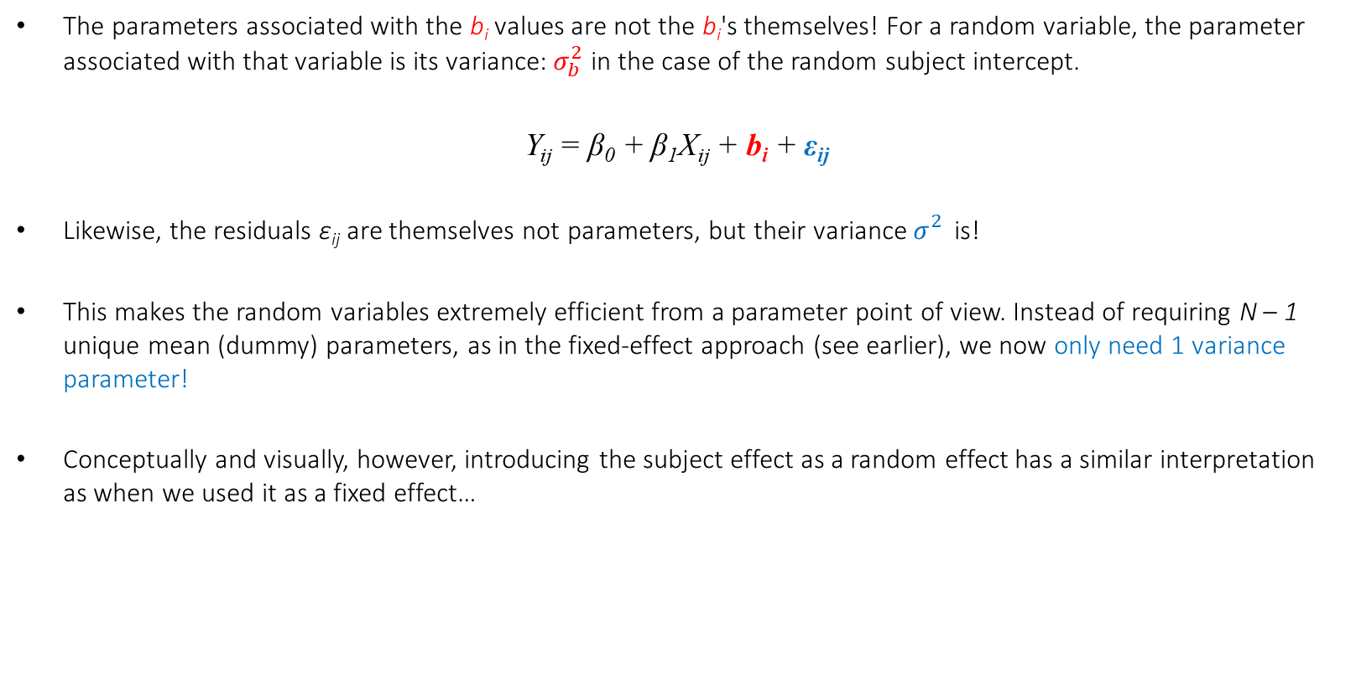
Random intercept model
The parameters associated with the b_{i} values are not the b_{i}'s themselves! For a random variable, the parameter associated with that variable is its variance: $σ_{b}^{2}$ in the case of the random subject intercept.
Y_{ij} = β₀ + β₁X_{ij} + b_{i} + ε_{ij}
Likewise, the residuals ε_{ij} are themselves not parameters, but their variance $σ_{}^{2}$ is!
This makes the random variables extremely efficient from a parameter point of view. Instead of requiring N – 1 unique mean (dummy) parameters, as in the fixed-effect approach (see earlier), we now only need 1 variance parameter!
Conceptually and visually, however, introducing the subject effect as a random effect has a similar interpretation as when we used it as a fixed effect…

Slide 15
Sleep deprivation example
50 students participate in a sleep deprivation study. The students are deprived of sleep for 10 hours, starting at 22:00. At 20 randomly selected sampling points during these 10 hours, the students perform an attentional task. Researchers are interested to see how attention (standardized) declines as a function of hours of sleep deprivation. The data in long format look like this:
Subject | Deprivation | Attention
ID1 | 0.4 | 0.367
ID1 | 1.3 | 0.594
ID1 | 3.9 | -0.513
ID1 | 4.4 | -0.465
ID1 | 6.4 | -1.282
ID1 | 9.9 | -2.389
… | … | …
ID50 | 9.0 | -1.536
Conventional rm-(M)ANOVA is not possible here, because deprivation varies continuously within subjects!
In wide format, we would need a separate column for every unique deprivation value, with many missing values in the resulting data matrix.
Let’s have a look at individual subjects’ data…

Slide 16
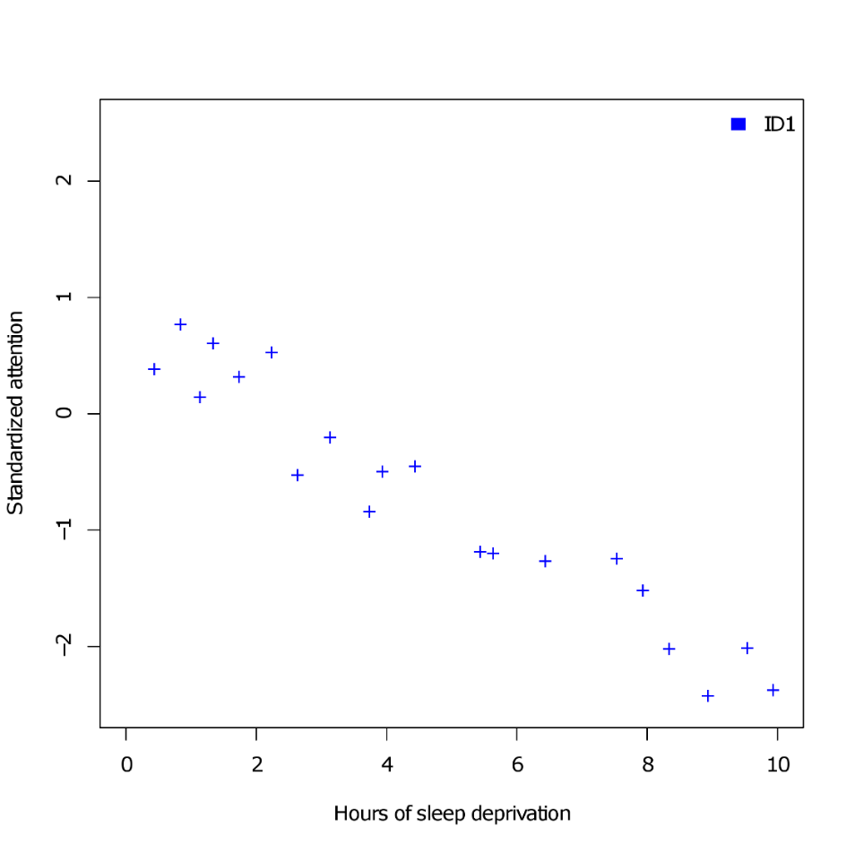
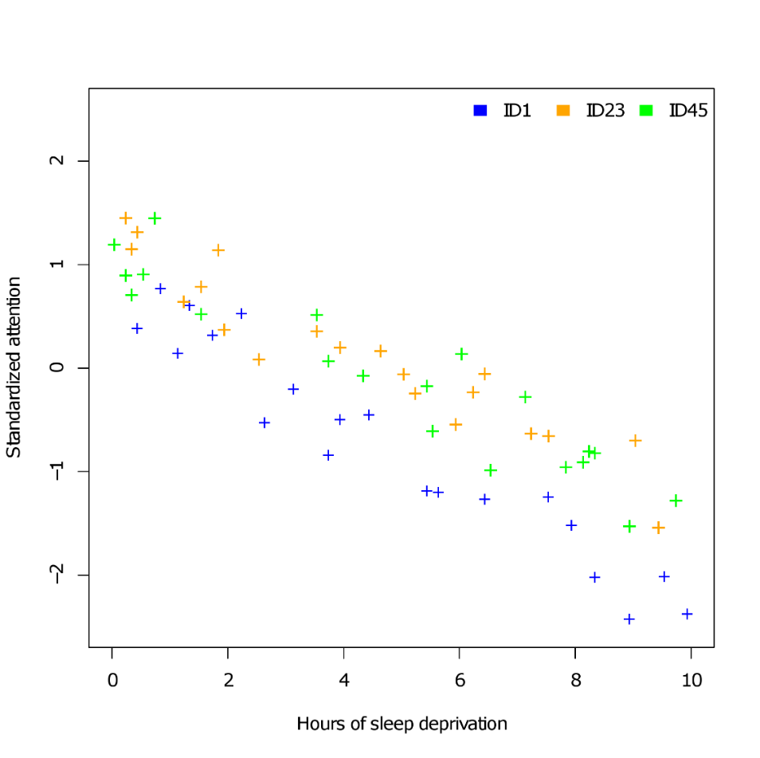
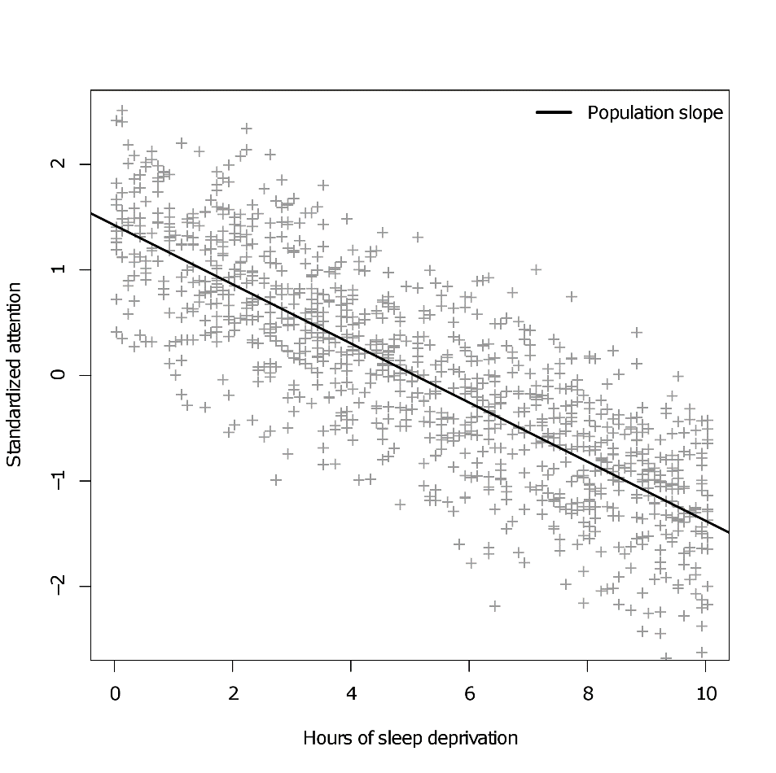
Sleep deprivation example
Subject 1 data
Subject 1, 23 & 45 data
All data with subject-averaged slope

Slide 17
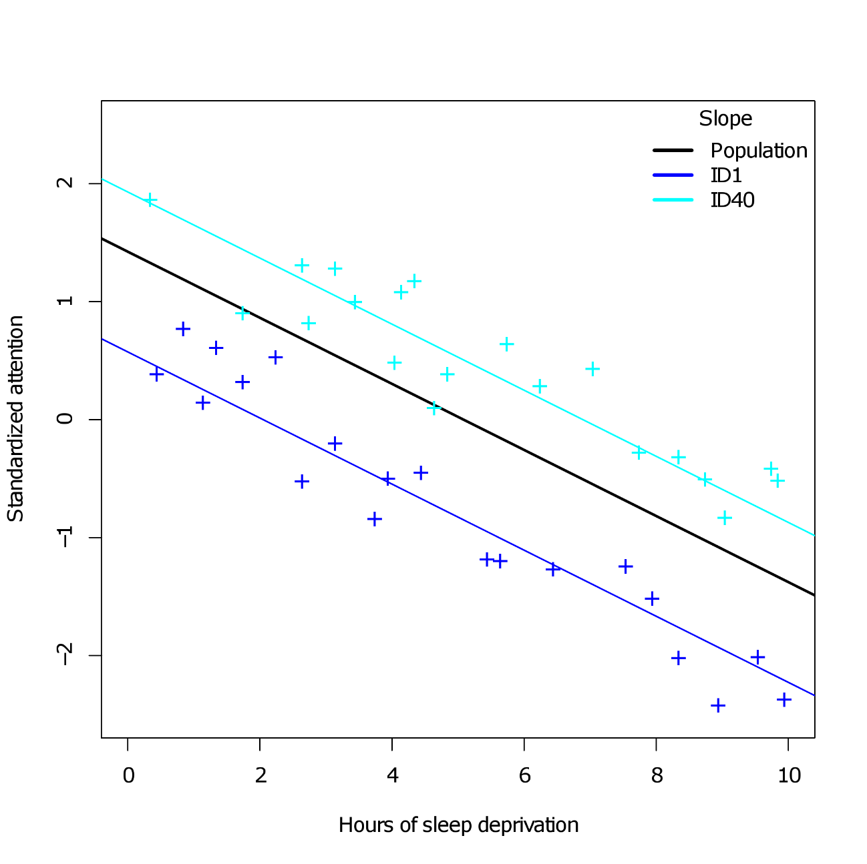


Sleep deprivation example
The random intercept model allows subjects to deviate from the population slope by a constant value:
Y_{ij} = β₀ + β₁X_{ij} + b_{i} + ε_{ij}
Error variance around the population slope is now decomposed into two distinct components:
  Variance due to subjects: intercepts vary randomly around the population slope
  Variance due to pure measurement error: error varies randomly around subject slopes
For this reason multilevel models are also often called variance components models.
$$σ_{}^{2}$$
$$σ_{b}^{2}$$

Slide 18

Marginal covariance in the random intercept model
For any given response point in the model, the variance is:
Var(Y_{ij}) = Var(b_{i}) + Var(ε_{ij}) = $σ_{b}^{2}$ + $σ_{}^{2}$
Likewise, the covariance between any pair of responses:
Cov(Y_{ij},Y_{ik}) = Cov(b_{i} + ε_{ij},b_{i} + ε_{ik})
= Cov(b_{i},b_{i}) + Cov(b_{i},ε_{ik}) + Cov(ε_{ij},b_{i}) + Cov(ε_{ij}, ε_{ik})

Slide 19

Marginal covariance in the random intercept model
For any given response point in the model, the variance is:
Var(Y_{ij}) = Var(b_{i}) + Var(ε_{ij}) = $σ_{b}^{2}$ + $σ_{}^{2}$
Likewise, the covariance between any pair of responses:
Cov(Y_{ij},Y_{ik}) = Cov(b_{i} + ε_{ij},b_{i} + ε_{ik})
= Cov(b_{i},b_{i}) + Cov(b_{i},ε_{ik}) + Cov(ε_{ij},b_{i}) + Cov(ε_{ij}, ε_{ik})
We have assumed that random intercepts and errors are uncorrelated. As per usual, we also assume that pairs of errors are uncorrelated.

Slide 20

Marginal covariance in the random intercept model
For any given response point in the model, the variance is:
Var(Y_{ij}) = Var(b_{i}) + Var(ε_{ij}) = $σ_{b}^{2}$ + $σ_{}^{2}$
Likewise, the covariance between any pair of responses:
Cov(Y_{ij},Y_{ik}) = Cov(b_{i} + ε_{ij},b_{i} + ε_{ik})
= Cov(b_{i},b_{i}) = Var(b_{i}) = $σ_{b}^{2}$

Slide 21
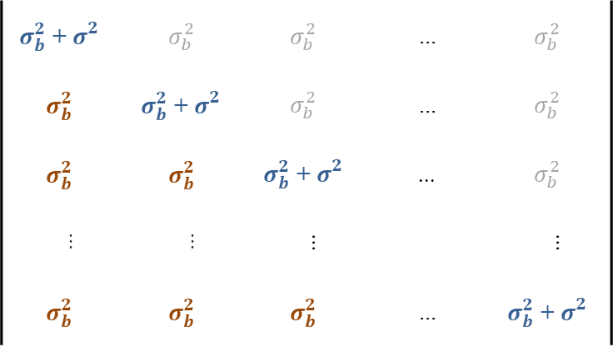
Marginal covariance – Sphericity returns…
The random intercept model implies the following structure for the marginal covariance matrix of the repeated measurements:
Cov(Y_{i}) =
So equal variances and equal covariances! We have seen this structure before, as sphericity in rm-ANOVA! For the random intercept model, this structure is usually called compound symmetry, but it is virtually equivalent to sphericity. Remarkably, we arrived at the identical marginal covariance by an entirely different approach.
$σ_{b}^{2}$ + $σ_{}^{2}$ | $$σ_{b}^{2}$$ | $$σ_{b}^{2}$$ | ... | $$σ_{b}^{2}$$
$$σ_{b}^{2}$$ | $σ_{b}^{2}$ + $σ_{}^{2}$ | $$σ_{b}^{2}$$ | ... | $$σ_{b}^{2}$$
$$σ_{b}^{2}$$ | $$σ_{b}^{2}$$ | $σ_{b}^{2}$ + $σ_{}^{2}$ | ... | $$σ_{b}^{2}$$
... | ... | ... |  | ...
$$σ_{b}^{2}$$ | $$σ_{b}^{2}$$ | $$σ_{b}^{2}$$ | ... | $σ_{b}^{2}$ + $σ_{}^{2}$

Slide 22

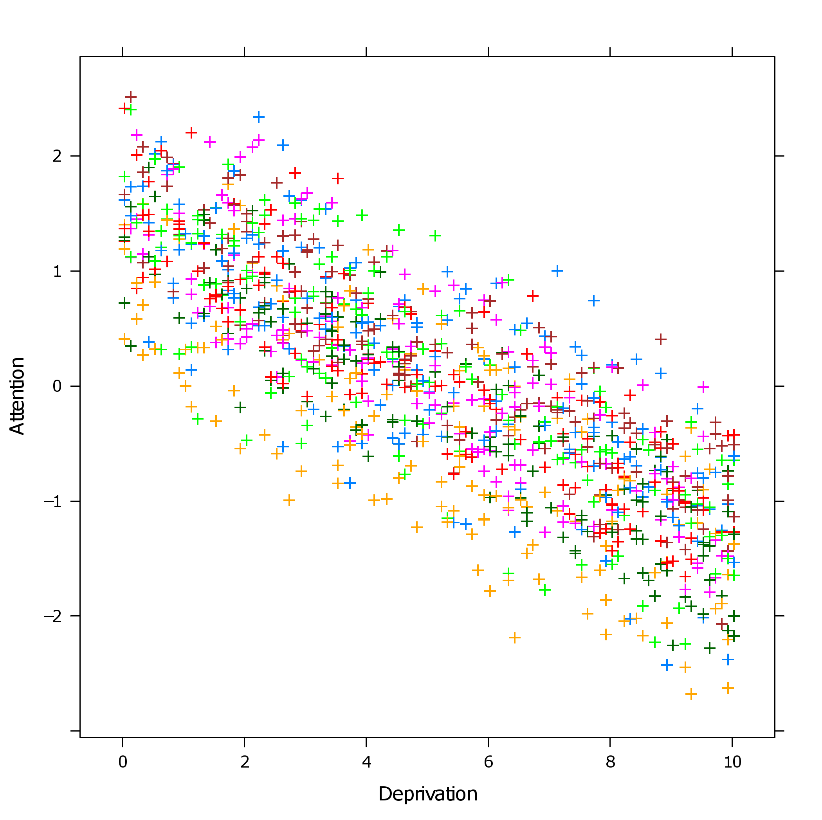
Fitting the model in R
We return to the sleep deprivation study. The data have been loaded into R and are already in the required long format:
There are 50 subjects, measured at 20 sampling points of sleep deprivation.
Subject Attention Deprivation
1 ID1 -1.2826490 6.4
2 ID1 0.3678006 0.4
3 ID1 -2.3895953 9.9
4 ID1 -0.4654373 4.4
5 ID1 -0.5133250 3.9
6 ID1 0.5942014 1.3
7 ID1 0.5128525 2.2
8 ID1 -2.4365818 8.9
9 ID1 -1.5338506 7.9
10 ID1 -0.2181901 3.1
...
1000 ID50 -1.5361430 9.0

Slide 23
Fitting the model in R
To fit a multilevel model to these data, we first load the required library:
library(lme4)
The main function for fitting multilevel models in the lme4 package is the lmer function. It uses a modified version of the typical linear regression formula syntax in R:
rint <- lmer(Attention ~ 1 + Deprivation + (1|Subject),data=sleep)
Dependent variable
Random effects
Fixed independent effects

Slide 24
Fitting the model in R
rint <- lmer(Attention ~ 1 + Deprivation + (1|Subject),data=sleep)
The dependent and independent variables are separated by the tilde operator ( ~ ). Among the fixed IVs, we specify a (population) intercept, denoted by the 1, plus an effect for Deprivation. This part of the formula is identical to how the lm function specifies ordinary regression models.*
Following the fixed variables, a random effects part is specified, which is separated between brackets, and which can be recognized by the appearance of the vertical stroke operator ( | ).
To the right of the vertical stroke, we specify a variable that contains repeated measurements (here Subject). To the left of the vertical stroke, we specifiy a random effects formula. If we only want a random intercept within subjects, we put the number 1, and nothing more.
The special random effects notation is basically telling R that there is clustering of repeated data within subjects!
*Also many other models in R use formula interfaces, e.g., machine learning models!

Slide 25
Fitting the model in R
The lmer function fits the model for us, and we have asked for the model to be stored in the object rint (as specified by the assignment operator, <- ). Next we can request a model summary with the summary function.
rint <- lmer(Attention ~ 1 + Deprivation + (1|Subject),data=sleep)
summary(rint)
The summary output first displays information about the fitting process, and the estimated model parameters:
Linear mixed model fit by REML
Formula: Attention ~ 1 + Deprivation + (1 | Subject)
Data: sleep
REML criterion at convergence: 542.4
Random effects:
Groups Name Variance Std.Dev.
Subject (Intercept) 0.25544 0.5054
Residual 0.08089 0.2844
Number of obs: 1000, groups: Subject, 50
Fixed effects:
Estimate Std.Error t-val
(Intercept) 1.42218 0.07379 19.27
Deprivation -0.28006 0.00315 -88.91

Slide 26

Fitting the model in R – Random effects parameters
The random variance is decomposed into subject intercepts ($σ_{b}^{2}$) and error ($σ_{}^{2}$). For these data, it appears the variance due to subjects is actually larger than variance due to measurement error.
Finally, the correlation between repeated measures can be calculated by: $σ_{b}^{2}$/($σ_{b}^{2}$+ $σ_{}^{2}$) = 0.759. So very high correlation between repeated measures! This quantity is also known as the intra-class coefficient (ICC)!
Linear mixed model fit by REML
Formula: Attention ~ 1 + Deprivation + (1 | Subject)
Data: sleep
REML criterion at convergence: 542.4
Random effects:
Groups Name Variance Std.Dev.
Subject (Intercept) 0.25544 0.5054
Residual 0.08089 0.2844
Number of obs: 1000, groups: Subject, 50
Fixed effects:
Estimate Std.Error t-val
(Intercept) 1.42218 0.07379 19.27
Deprivation -0.28006 0.00315 -88.91

Slide 27
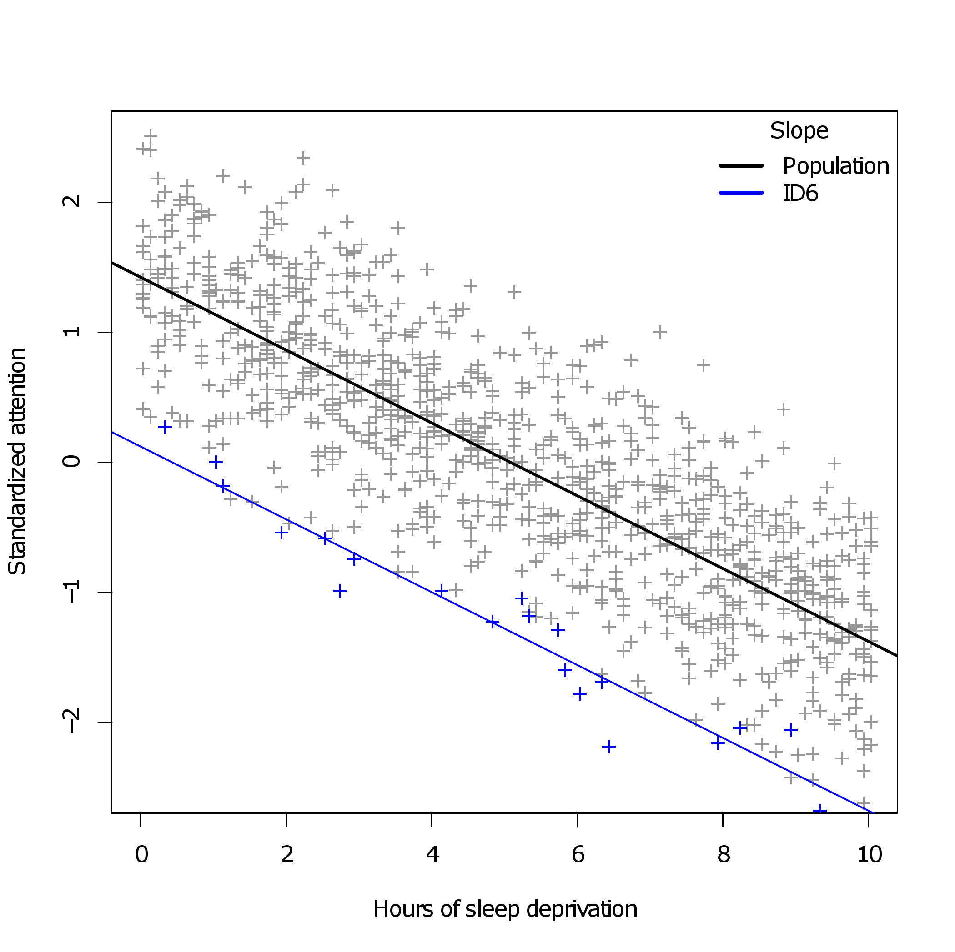
Fitting the model in R – Random effects values
The ranef function returns the values for the random intercepts, which are the b_{i}'s discussed earlier. These values denote the deviation of each subject from the population intercept!
ranef(rint)
$Subject
(Intercept)
ID1 -0.84966183
ID10 -0.25942567
ID11 -0.63440995
ID12 0.04833887
ID13 -0.85732489
ID14 0.57371996
...
ID6 -1.30205651
It appears that subject 6 is particularly outlying from the population intercept.

Slide 28
Fitting the model in R – Fixed effects parameters
The fixed effects reveal a negative association between hours of sleep deprivation and degree of attention, as expected from the graphs we plotted.
Pop quiz:
  What is the exact interpretation of the (Intercept) parameter?
  What is the exact interpretation of the Deprivation parameter?
Attention ~ 1 + Deprivation + (1|Subject)
Random effects:
Groups Name Variance Std.Dev.
Subject (Intercept) 0.25544 0.5054
Residual 0.08089 0.2844
Number of obs: 1000, groups: Subject, 50
Fixed effects:
Estimate Std.Error t-val
(Intercept) 1.42218 0.07379 19.27
Deprivation -0.28006 0.00315 -88.91

Slide 29

Fitting the model in R – Fixed effects parameters
So… where is my p-value?
For the Santa Claus data, we got a nice column with p-values and a table of significance codes. How do I decide for the sleep data if the deprivation effect is statistically significant? What are the degrees of freedom for the t-value…?
Attention ~ 1 + Deprivation + (1|Subject)
Random effects:
Groups Name Variance Std.Dev.
Subject (Intercept) 0.25544 0.5054
Residual 0.08089 0.2844
Number of obs: 1000, groups: Subject, 50
Fixed effects:
Estimate Std.Error t-val
(Intercept) 1.42218 0.07379 19.27
Deprivation -0.28006 0.00315 -88.91
Belief ~ Age + Gender + Siblings + Rank + Easter_bunny
Coefficients:
Estimate Std. Error t value Pr(>|t|)
(Intercept) 5.487031 0.312914 17.535 < 2e-16 ***
Age -0.769430 0.029532 -26.054 < 2e-16 ***
Gendergirl 0.022870 0.145955 0.157 0.876
Siblings 0.002239 0.073478 0.030 0.976
Rank 0.069784 0.130941 0.533 0.594
Easter_bunny 0.152862 0.030902 4.947 1.27e-06 ***
---
Signif. codes: 0 ‘***’ 0.001 ‘**’ 0.01 ‘*’ 0.05 ‘.’ 0.1 ‘ ’ 1
???

Slide 30
Inference on fixed effects in multilevel models
For the standard linear model, with constant variance and uncorrelated errors, degrees of freedom for inferential tests (t-tests and F-tests) are known exactly.
For models where the variance is non-constant and the covariance possibly complex, degrees of freedom are not known exactly. It is not even certain that the distribution of the test statistic (under the null hypothesis) has a t- or F-distribution.
Different software/books/authors have attempted various solutions to this problem:
  Theoretical approximations to the degrees of freedom (e.g., Satterthwaite, Kenward-Roger). Implemented in SAS, SPSS, and the R packages pbkrtest and lmerTest.
  Bayesian approaches that approximate the null distribution empirically. Implemented in the now defunct R package languageR, and more recently in mcmGLMM.
  Bootstrapping procedures for acquiring empirical confidence intervals for hypothesis testing. Possible via the bootMer function in lme4
  The R package lme4 by itself considers the DF issue unresolved and refuses to print p-values until it is!

Slide 31
Fixed effects inference with lmerTest
Using the lmerTest package in R:
Finally we have degrees of freedom and a p-value, yielding a significant deprivation effect. Note the fractional degrees of freedom due to Satterthwaite's approximation. We have seen fractional degrees of freedom before in the Greenhouse-Geisser correction for sphericity!
library(lmerTest)
rint <- lmer(Attention ~ 1 + Deprivation + (1|Subject),data=sleep)
summary(rint)
Linear mixed model fit by REML
t-tests use Satterthwaite approximations to degrees of freedom
[...]
Fixed effects:
Estimate Std.Error df t-val P-val
(Intercept) 1.42218 0.07379 53.90000 19.27 <2e-16 ***
Deprivation -0.28006 0.00315 950.10000 -88.91 <2e-16 ***
---
Signif. codes: 0 ‘***’ 0.001 ‘**’ 0.01 ‘*’ 0.05 ‘.’ 0.1 ‘ ’ 1

Slide 32

Caution with the random-intercept model!
But wait a minute, what exactly is going on here…?
The degrees of freedom are enormous, close to 1000, which is nearly the total number of observations (50 subjects × 20 measurements).
Does this suggest our 1000 observations are nearly independent? The answer is a strong no.
The DFs are reduced somewhat here by the size of the random intercept variance, but they remain extremely large because of the simple model imposed by the random intercept on repeated measures covariance.
Fixed effects:
Estimate Std.Error df
(Deprivation -0.28006 0.00315 950.10000
---

Slide 33
Caution with the random-intercept model!
Recall that the random intercept model is virtually equivalent to uncorrected repeated measures ANOVA which assumes sphericity. Hence, these two models should be treated as equally simplistic.
If sphericity/compound symmetry is violated—and very often it is—the random intercept model will dramatically overestimate the degrees of freedom for fixed effects tests. The statistical power of this model is attractive but can be very misleading!
For this reason, the random intercept model should rarely be the final model for the random effects! The random effects should always be as complex as the data allows! Doing so will typically reduce the degrees of freedom to more realistic estimates (although can still be relatively high).
Next we will see how we can make our random effects more complex…

Slide 34
Axis of parametric complexity – Marginal and hierarchical models
Greenhouse-Geisser rm-ANOVA
Marginal autoregressive
Marginal Toeplitz
Random slopes LMM
Random intercepts LMM
...
Model name
Standard LM
Rm-ANOVA
Random-intercept LMM
Rm-MANOVA
WLS
GLS
Identity
Sphericity
Compound symmetry
Almost everything else…
Unstructured
(repeated covariance)
Unstructured
(residual covariance)

Slide 35
Axis of parametric complexity – Marginal and hierarchical models
ε | 1 | 2 | 3 | 4 | 5 | 6 | 7 | 8 | 9 | ... | N
1 | σ² | 0 | 0 | 0 | 0 | 0 | 0 | 0 | 0 | ... | 0
2 | 0 | σ² | 0 | 0 | 0 | 0 | 0 | 0 | 0 | ... | 0
3 | 0 | 0 | σ² | 0 | 0 | 0 | 0 | 0 | 0 | ... | 0
4 | 0 | 0 | 0 | σ² | 0 | 0 | 0 | 0 | 0 | ... | 0
5 | 0 | 0 | 0 | 0 | σ² | 0 | 0 | 0 | 0 | ... | 0
6 | 0 | 0 | 0 | 0 | 0 | σ² | 0 | 0 | 0 | ... | 0
7 | 0 | 0 | 0 | 0 | 0 | 0 | σ² | 0 | 0 | ... | 0
8 | 0 | 0 | 0 | 0 | 0 | 0 | 0 | σ² | 0 | ... | 0
9 | 0 | 0 | 0 | 0 | 0 | 0 | 0 | 0 | σ² | ... | 0
... | ... | ... | ... | ... | ... | ... | ... | ... | ... |  | 0
N | 0 | 0 | 0 | 0 | 0 | 0 | 0 | 0 | 0 | 0 | σ²

Slide 36
2. Random intercept and random slope model
B. Random slope model

Slide 37
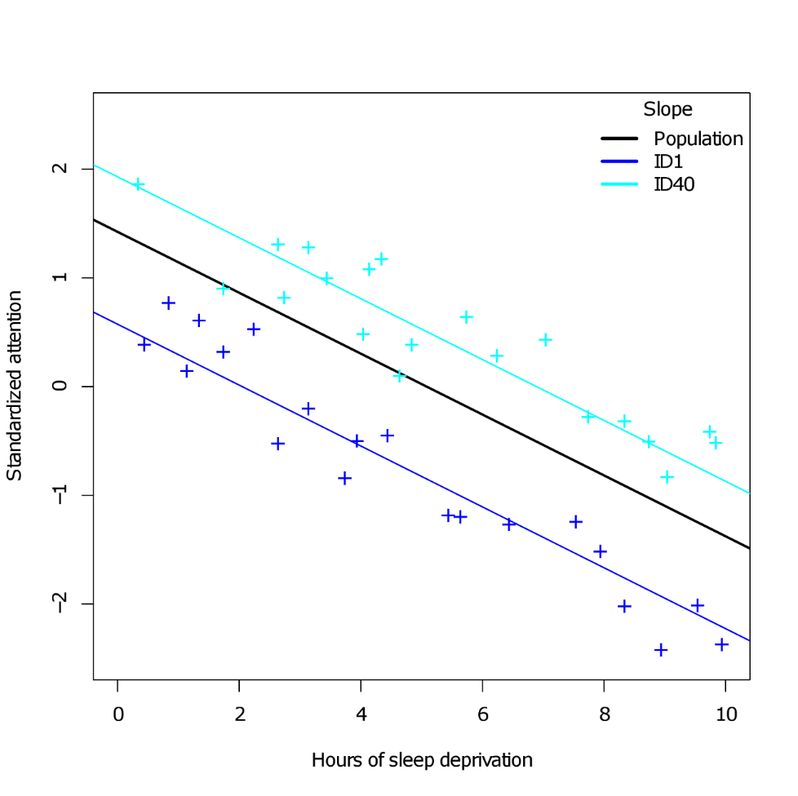
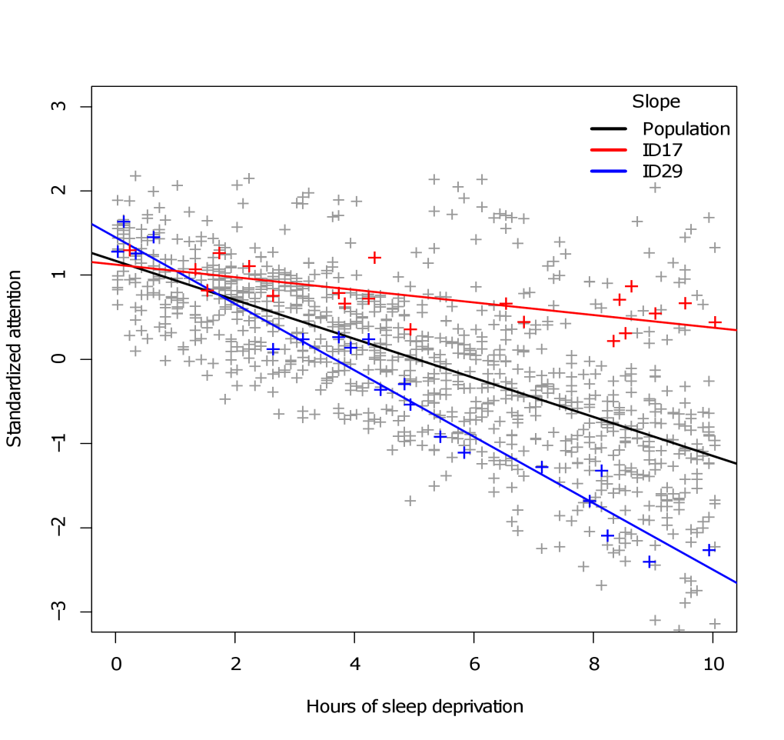
Random slopes
Sometimes/often, subjects not only differ with respect to their baseline deviation from the population trend/effect, but also with respect to the trend/effect itself. Such individual differences would be called random slopes.

Slide 38
Random slope model
Let us now extend the random intercept model with additional random effects. Again, for simple one-way regression:
Y_{ij} = β₀ + β₁X_{ij} + b_{0i} + b_{1i}X_{ij} + ε_{ij}
β₀ The population intercept. The baseline response, across subjects, when X_{ij} = 0
β₁ The population slope. The rate of change between X and Y, across subjects
b_{0i} A between-subject intercept. A deviation of the population intercept
for the i^{th} subject
b_{1i} A within-subject slope. A deviation of the population slope for X_{ij}
for the i^{th} subject
ε_{ij} A within-subject error. A constant deviation of the population response
for the i^{th} subject for the j^{th} repeat

Slide 39
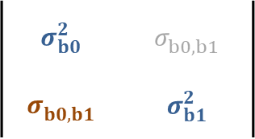
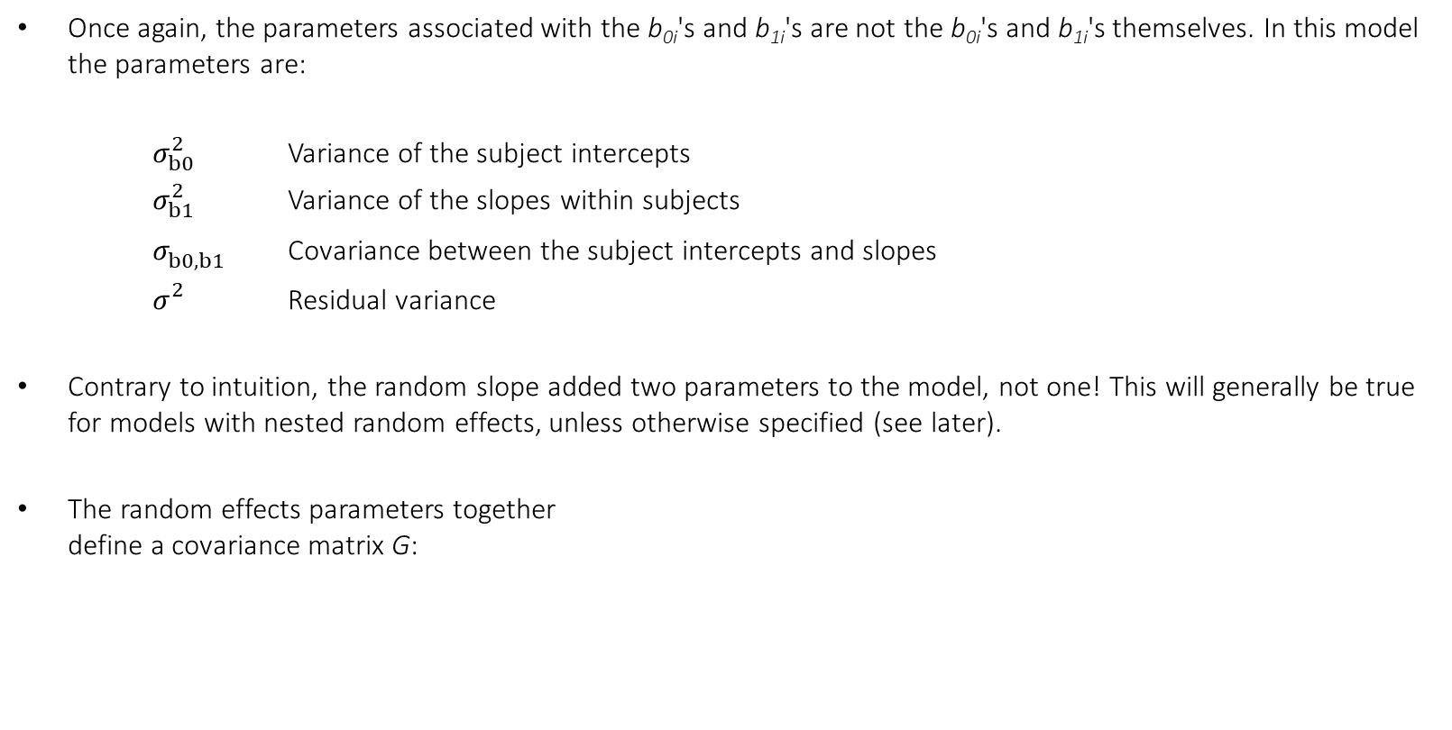
Random slope model
Once again, the parameters associated with the b_{0i}'s and b_{1i}'s are not the b_{0i}'s and b_{1i}'s themselves. In this model the parameters are:
$σ_{b0}^{2}$ Variance of the subject intercepts
$σ_{b1}^{2}$ Variance of the slopes within subjects
$σ_{b0,b1}^{}$ Covariance between the subject intercepts and slopes
$σ_{}^{2}$ Residual variance
Contrary to intuition, the random slope added two parameters to the model, not one! This will generally be true for models with nested random effects, unless otherwise specified (see later).
The random effects parameters together
define a covariance matrix G:
$$σ_{b0}^{2}$$ | $$σ_{b0,b1}^{}$$
$$σ_{b0,b1}^{}$$ | $$σ_{b1}^{2}$$
Cov(b_{i}) =

Slide 40

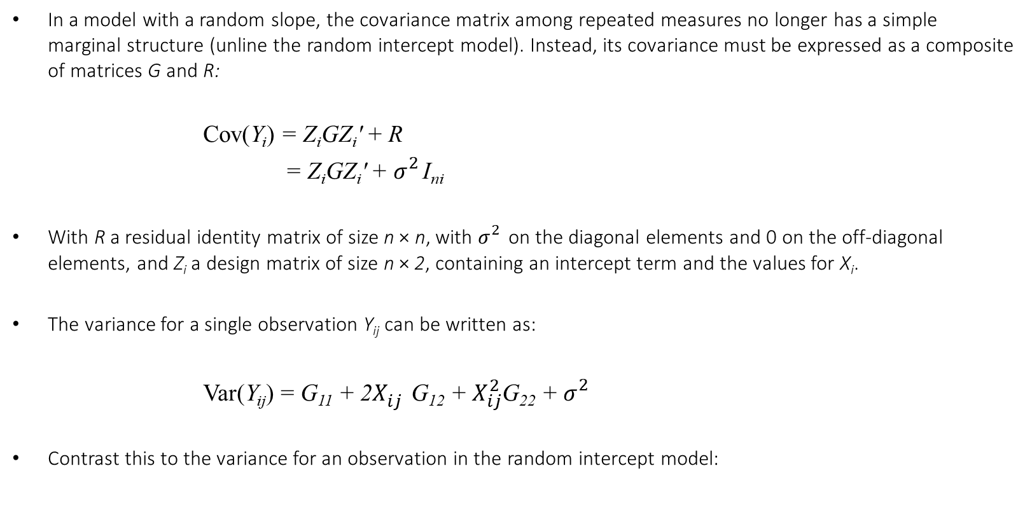
Random slope model
In a model with a random slope, the covariance matrix among repeated measures no longer has a simple marginal structure (unline the random intercept model). Instead, its covariance must be expressed as a composite of matrices G and R:
Cov(Y_{i}) = Z_{i}GZ_{i}' + R
Cov(Y_{ij}) = Z_{i}GZ_{i}' + $σ_{}^{2}$I_{ni}
With R a residual identity matrix of size n × n, with $σ_{}^{2}$on the diagonal elements and 0 on the off-diagonal elements, and Z_{i} a design matrix of size n × 2, containing an intercept term and the values for X_{i}.
The variance for a single observation Y_{ij} can be written as:
Var(Y_{ij}) = G₁₁ + 2$X_{ij}^{}$G₁₂ + $X_{ij}^{2}$G₂₂ + $σ_{}^{2}$
Contrast this to the variance for an observation in the random intercept model:
Var(Y_{ij}) = $σ_{b}^{2}$ + $σ_{}^{2}$

Slide 41
Random slope model
In the random slope model, the (co)variance of the response values becomes a function of the random slope variable's values!
This allows that variance around the population slope changes for increasing values. This is particularly useful for explaining and dealing with heteroscedasticity in repeated data!
In this sense, random slopes can be considered as a natural form of weighted least squares (WLS) regression.
Random slopes thus reflect known sources of repeated measures covariation.

Slide 42
Fitting the model in R – Modified formula syntax
In R, we keep the fixed effects part our model formula identical to the random intercept model. However, we extend the random effects specification:
rslope <- lmer(Attention~ 1+Deprivation+ (1+Deprivation|Subject),data=sleep)
This time, we speficy that there should be randomly varying intercepts (1), and randomly varying Deprivation slopes (+Deprivation) within subjects.
The fixed effects formula and the random effects formula are now identical. This highlights that any predictor that was measured repeatedly within subjects can appear both in the fixed effects and the random effects of the model!

Slide 43

Fitting the model in R – Output
Summary output of the random slopes model:
Three sources of random variation now: intercepts ($σ_{b0}^{2}$) and deprivation slopes ($σ_{b1}^{2}$) in subjects, and error for measurements ($σ_{}^{2}$). In addition, there is a correlation parameter ($σ_{b0,b1}^{}$) between intercepts and slopes.
rslope <- lmer(Attention ~ 1+Deprivation+(1+Deprivation|Subject),data=sleep)
summary(rslope)
Random effects:
Groups Name Variance Std.Dev. Corr
Subject (Intercept) 2.507e-01 0.5006683
Deprivation 8.746e-07 0.0009352 1.00
Residual 8.089e-02 0.2844036
Number of obs: 1000, groups: Subject, 50
Fixed effects:
Estimate Std.Error df t-val P-val
(Intercept) 1.422305 0.073144 49.200000 19.45 <2e-16 ***
Deprivation -0.280077 0.003152 894.600000 -88.85 <2e-16 ***
---
Signif. codes: 0 ‘***’ 0.001 ‘**’ 0.01 ‘*’ 0.05 ‘.’ 0.1 ‘ ’ 1

Slide 44
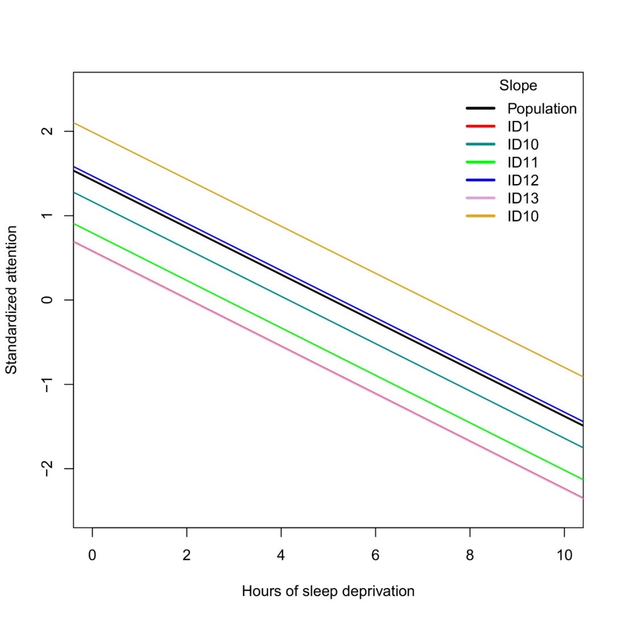
Do we need the random slopes?
Random effects values within subjects with the ranef function:
$Subject
(Intercept) Deprivation
ID1 -0.84276736 -1.574242e-03
ID10 -0.25625796 -4.786756e-04
ID11 -0.62784813 -1.172785e-03
ID12 0.04791784 8.950785e-05
ID13 -0.84839131 -1.584748e-03
ID14 0.56839192 1.061724e-03
ID15 -0.02916347 -5.447574e-05
...
The slope deviations all seem rather small. The summary output indicated that variation due to random slopes is equal to 0.0000008746, which is virtually negligible.
Do we really need the random slopes for these data?

Slide 45
Do we need the random slopes?
Conventionally, models are compared with statistical tests, e.g., ANOVA F-tests or, more generally, Wald and likelihood ratio tests. Several software offer these tests for random effects parameters. However, such tests are problematic for three important reasons:
  Boundary problem: Testing whether a (co)variance parameter is non-zero is a test on the boundary of the parameter space. Unlike regression coefficients, which are theoretically unbounded, [–∞,+∞], a (co)variance parameter is bounded to [0,+∞]. Classical maximum likelihood theory (e.g., asymptotic normality) breaks down at these boundaries.
  Non-nesting: Traditional inferential model comparisons depend on models being nested. That is, the parameters of the reduced model should be a subset of the parameters of the full model. For comparisons between complex random effects structures, this is not always the case.
  Hypotheses: Unlike fixed effects, random effects are rarely the subject of scientific hypotheses. Conducting inferential tests on these parameters would unnecessarily inflate the multiple testing problem.

Slide 46

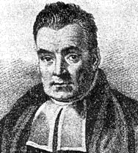

Information criteria
A general method for comparing models is by information criteria. The most common are Akaike Information Criterion (AIC) and Bayesian Information Criterion (BIC).
AIC/BIC quantify relative model fit, penalized by the number of parameters. It can be thought of as a measure of relative generalization.
AIC/BIC are a statistical version of a principle known as Occam's Razor, which is a heuristic to “explain a phenomenon as best as possible with the least amount of assumptions”. Analogously, we want a good-fitting model with few parameters.
Among competing models, the one that minimizes AIC/BIC is often chosen to be the optimal one. For this comparison, differences of 2 AIC/BIC points are already considered meaningful.
For reasons that will be explained later, AIC is ideal to perform a selection of random effects…
Akaike
Bayes
Occam

Slide 47
Information criteria
Information criteria have many important advantages:
  They penalize a model for extra parameters (unlike other fit measures, such as R²)
  They can be used to compare non-nested models (unlike conventional ANOVA F-tests)
  They avoid frequentist inference (and many of its problems) based on p-values
  They are related to Bayes factors and Bayesian inference
  In a group of models, they can be used to quantify the relative probability of each model
In my opinion, model selection using AIC/BIC is superior to hypothesis testing in many settings, not just multilevel models. It can be applied for stepwise regression selection, cluster analysis, factor analysis, structural equation modelling, and in artificial neural networks. Whenever these measures are available, they should be used!
Information criteria are particularly well-suited to the selection of random effects structures since they entirely avoids the problems with inferential tests mentioned earlier. Let us re-examine the sleep data with them…

Slide 48
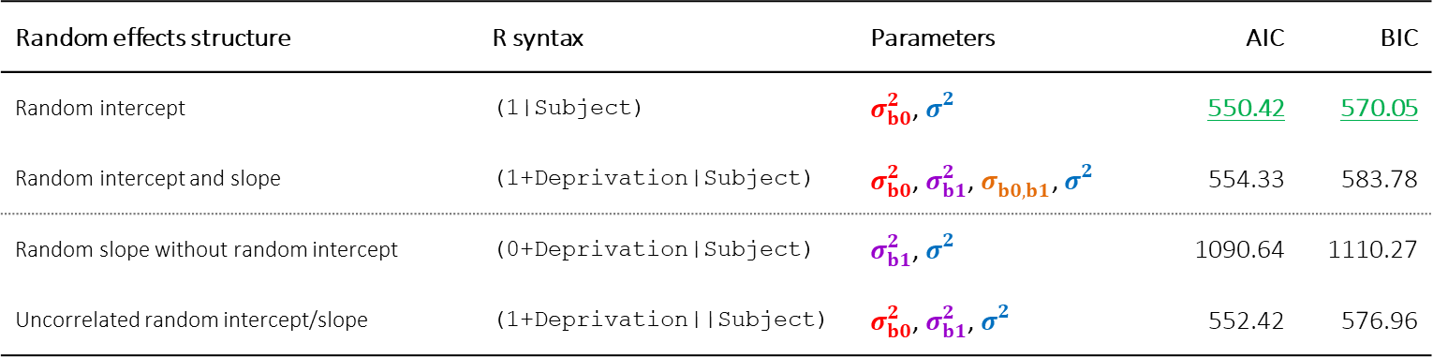
Information criteria in R
In R, it suffices to run the AIC or BIC functions on our model objects:
AIC(rint) ; BIC(rint)
AIC(rslope) ; BIC(rslope)
Which yields the following results. Minimal AIC/BIC for the random intercept model. Adding the random Deprivation slope increases the model’s AIC by 4 points, and BIC by 13 points (which is larger than 2).
Random effects structure | R syntax | Parameters | AIC | BIC
Random intercept | (1|Subject) | $σ_{b0}^{2}$, $σ_{}^{2}$ | 550.42 | 570.05
Random intercept and slope | (1+Deprivation|Subject) | $σ_{b0}^{2}$, $σ_{b1}^{2}$, $σ_{b0,b1}^{}$, $σ_{}^{2}$ | 554.33 | 583.78
Random slope without random intercept | (0+Deprivation|Subject) | $σ_{b1}^{2}$, $σ_{}^{2}$ | 1090.64 | 1110.27
Uncorrelated random intercept/slope | (1+Deprivation||Subject) | $σ_{b0}^{2}$, $σ_{b1}^{2}$, $σ_{}^{2}$ | 552.42 | 576.96
Caution!

