Slide 1



Logistic Regression III
Ben Meuleman, Ph.D.
Swiss Center for Affective Sciences
Université de Genève
Workshop series on advanced statistical topics
November 17, 2022

Slide 2
Contents
Analysis of frequency tables
  Proportions and binomial tests
  2 × 2 tables – Odds ratios
  A × B tables – Chi-square analysis
  A × B × C tables – Log-linear analysis
Binary logistic regression
  Two-group difference
  Continuous predictor
  Multiple predictors
  Model fit and diagnostics
  Extensions to logistic regression
Analysis of paired categorical data

Slide 3
3. Analysis of paired categorical data

Slide 4
Paired categorical data
So far we have predicted a categorical response from other variables, sometimes themselves categorical. It may also occur that we measure the same categorical response twice, and as such have a paired categorical sample. For example:
    Participants choose one of 2 products before (T1) and after (T2) an information intervention. Pre and post choices are cross-tabulated (2×2).
    Two raters code the use of 8 emotion regulation strategies from written survey responses to recalled events. Raters' classifications are cross-tabulated (8×8).
    A statistical model predicts death on Game of Thrones. Model predictions are cross-tabulated against the true death outcomes (2×2).
We have already seen the last example when discussing model goodness-of-fit for logistic regression. The others are more general examples of paired categorical data, such that the resulting frequency table is A × A square.
Chi-square and log-linear analyses have been developed to deal with these cases. Let us examine these.

Slide 5


An intervention study
Morpheus has realized that his red/blue pill dilemma may not be entirely ethical. He therefore conducts an experiment in the matrix with 200 people targeted to be freed. He first offers them the original choice of blue=ignorance and red=unknown (T1). Once they have chosen, he tells them the truth about the matrix, and re-offers the pill choice (T2). He records the following responses:
A chi-square test is extremely significant, with an OR=7.79. But is this truly an informative test here…?
 | Pill T2
Pill T1 | Blue | Red
Blue | 51 | 12
Red | 48 | 89
Pearson's Chi-squared test with Yates' continuity correction
data: pills
X-squared = 34.583, df = 1,
p-value = 4.085e-09
OR = 7.79

Slide 6
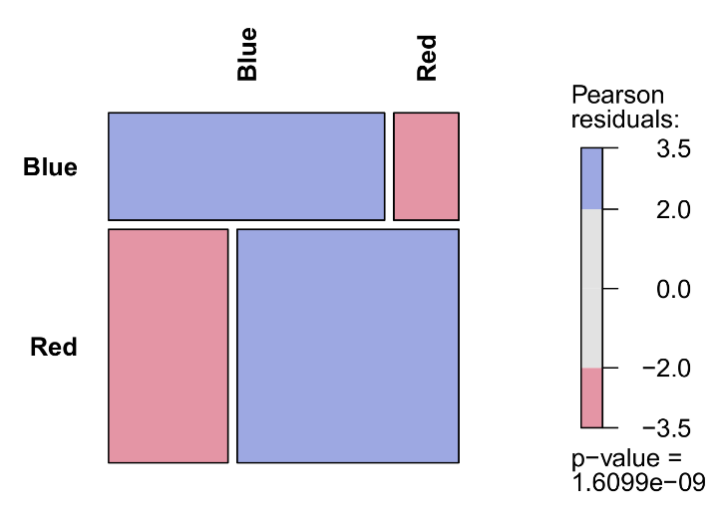
Marginal homogeneity
A chi-square analysis is usually trivial for paired categorical data, in that the largest frequencies are expected to occur on the diagonal, and hence the null hypothesis of A × A independence will be rejected.
All it confirms here is that people tend to stick with their choice, e.g., those who chose blue before the truth stick with blue after.
The more interesting question that suggests itself for these data is whether the marginal distribution of pill choices changes between T1 and T2 (green cells)? This question addresses the null hypothesis of marginal homogeneity.
 | Pill T2
Pill T1 | Blue | Red
Blue | 51 | 12 | 63
Red | 48 | 89 | 137
 | 99 | 101

Slide 7


Marginal homogeneity
It may be tempting to run our chi-square analysis on the left table below but this is wrong! The same person is now observed in two cells of the table, which means the counts are no longer independent, as is required for a chi-square test.
In the original table, every person is only in one cell, thus preserving independence. We can run McNemar's test of marginal homogeneity on this table:
mcnemar.test(pills)
 | Time
Pill | T1 | T2
Blue | 63 | 99
Red | 137 | 101
 | Pill T2
Pill T1 | Blue | Red
Blue | 51 | 12
Red | 48 | 89
McNemar's Chi-squared test with continuity correction
data: pills
McNemar's chi-squared = 20.417, df = 1,
p-value = 6.228e-06

Slide 8
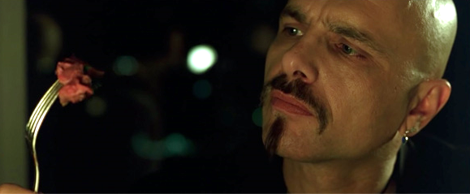
Marginal homogeneity
The test is highly significant so we reject marginal homogeneity. In other words, there was a significant change in pill choice distribution between T1 and T2. Follow-up tests can be done with regular proportion tests, e.g., on the margin tables:
So strong preference for red pills before Morpheus tells the truth, and equal preference for red and blue after the truth. This result does not quite capture the effect of the intervention, however. From the table it is clear that people primarily switched from red to blue, rather than vice-versa. It is this asymmetry that rejected marginal homogeneity. We should explicitly compare the two off-diagonal cells of our table:
prop.test(48,48+12)
It turns out that this is identical to McNemar's test! This also illustrates that, in a 2×2 table, symmetry implies marginal homogeneity, and vice-versa.
margin.table(pills,1) prop.test(63,200) X2 = 26.645, df=1, p=2.445e-07
margin.table(pills,2) prop.test(99,200) X2 = 0.005, df=1, p=0.9436
1-sample proportions test with continuity correction
data: 48 out of 60, null probability 0.5
X-squared = 20.417, df = 1, p-value = 6.228e-06

Slide 9
K × 2 × 2 analysis
Morpheus extends his experiment to find out why people switch pills. He stratifies the sample by age (young, old), to obtain a 2×2×2 table. Inspecting the frequencies, it seems that the information intervention mainly prompted older people to switch choice.
With our knowledge that McNemar's test is simply a proportion test on the diagonal frequencies, we can extend the analysis easily to include K independent groups.
We rearrange our table to include only the diagonal frequencies, and then run a chi-square test on that table. A significant result implies that groups differed in marginal time homogeneity. Follow-up proportion tests can confirm the direction of the pattern.
age <- array(c(9,3,14,34),dim=c(2,2), dimnames=list(Age=c("Young","Old"),
T1_T2=c("Blue-Red","Red-Blue")))
chisq.test(age)
prop.test(9,9+14)
prop.test(3,3+34)
 |  | Pill T2
Age | Pill T1 | Blue | Red
Young | Blue | 20 | 9
 | Red | 14 | 57
Old | Blue | 31 | 3
 | Red | 34 | 32
 | T1-T2
Age | Blue-Red | Red-Blue
Young | 9 | 14
Old | 3 | 34
χ²(1) = 6.70, p = 0.0096

Slide 10
Rater agreement
319 people responded to a survey on stressful life events. An event is recalled and the respondent describes how they coped with it.
The written responses are then coded by two experts on emotion regulation, who classify the coping behavior into 1 of 8 regulation strategies. The classifications of the two raters are cross-tabulated.
Once again, the largest counts are on the diagonal, suggesting that the two raters agree substantially.
As well, there seem to be notable “confusions” (light blue cells), in that disagreements are between similar regulation strategies (e.g., reappraisal and humor).
 | Rater B
Rater A | Avoidance | Problem solving | Reappraisal | Humor | Relaxation | Acceptance | Suppression | Social support
Avoidance | 22 | 0 | 0 | 0 | 0 | 2 | 0 | 2 | 26
Problem solving | 0 | 32 | 8 | 0 | 1 | 0 | 0 | 1 | 42
Reappraisal | 0 | 6 | 50 | 9 | 0 | 2 | 0 | 0 | 67
Humor | 0 | 0 | 12 | 28 | 0 | 1 | 0 | 4 | 45
Relaxation | 0 | 0 | 0 | 0 | 47 | 15 | 0 | 0 | 62
Acceptance | 1 | 0 | 7 | 2 | 10 | 23 | 0 | 0 | 43
Suppression | 0 | 0 | 0 | 0 | 0 | 0 | 5 | 0 | 5
Social support | 2 | 4 | 0 | 3 | 0 | 0 | 1 | 19 | 29
 | 25 | 42 | 77 | 42 | 58 | 43 | 6 | 26

Slide 11
Rater agreement
Inspecting the table margins, the distribution of classifications is nearly identical. There seems to be no evidence for significant disagreement.
Cohen proposed a measure of rater agreement for A × A tables known as Cohen's Kappa. Kappa will be equal to 0 when the raters are completely independent, and equal to 1 when agreement is perfect. Negative values may occur if there is strong (to perfect) disagreement but this is rare in practice. For the regulation data, we use CohenKappa from DescTools:
CohenKappa(regul,conf.level=0.95)
A value of 0.655 indicates strong agreement. The version above is the so-called “unweighted” Kappa. Weighted versions have been proposed that take advantage of ordinal categories by downweighting adjacent confusions. Other generalizations allow Kappa to be calculated for more than 2 raters, such as available in DescTools with the function KappaM.
kappa lwr.ci upr.ci
0.655 0.596 0.714

Slide 12
Rater agreement
Can we also test for marginal homogeneity? McNemar's test does not generalize to A × A tables, but a log-linear alternative is available that is little known. The test is available in the custom script square_tests.r with the function square.tests. Let us run this on the regulation data:
source("C:/myfilepath/square_tests.r")
square.tests(regul)
The test is non-significant, χ²(7) = 5.592, p = 0.5881, so we accept marginal homogeneity. Contrary to the intervention example, for rater agreement we normally hope to accept the null hypothesis! Marginal heterogeneity would imply significant disagreement!
A number of other tests appear in the output which we have not yet discussed…
Test LRT DF P
1 Independence 719.817400 49 0.000000e+00
2 Quasi-independence 157.746720 41 1.332268e-15
3 Symmetry 10.188428 28 9.991678e-01
4 Quasi-symmetry 4.596438 21 9.999346e-01
5 Marginal homogeneity 5.591991 7 5.881125e-01

Slide 13
Quasi-independence
The standard chi-square test is found at the top of the output, under “independence”. As expected, the result is massively significant and uninteresting. However, what if we ignored the diagonal cells and ran the chi-square analysis only on the off-diagonal cells? This is a null hypothesis of quasi-independence, i.e., the rows and columns are independent, disregarding the diagonal cells.
While we have previously tested off-diagonal independence with McNemar's test, in 2×2 tables quasi-independence, marginal homogeneity and symmetry coincide, whereas this is not necessarily true for A × A tables.
For more general tables, quasi-independence essentially tests whether the pattern of confusions is random. A rejection would imply that some levels are confused more than expected under independence. This seems to be the case for the regulation data (e.g., reappraisal-humor, relaxation-acceptance) and unsurprisingly, the test for quasi-independence is strongly significant in the square.tests output, χ²(41) = 157.7, p < 0.0001.
The underlying model for this test is a log-linear regression where the diagonal values of the table are treated as “structural zeroes” by the use of dummy variables (one for each diagonal cell). The technical details are explained further in Agresti (2002).

Slide 14
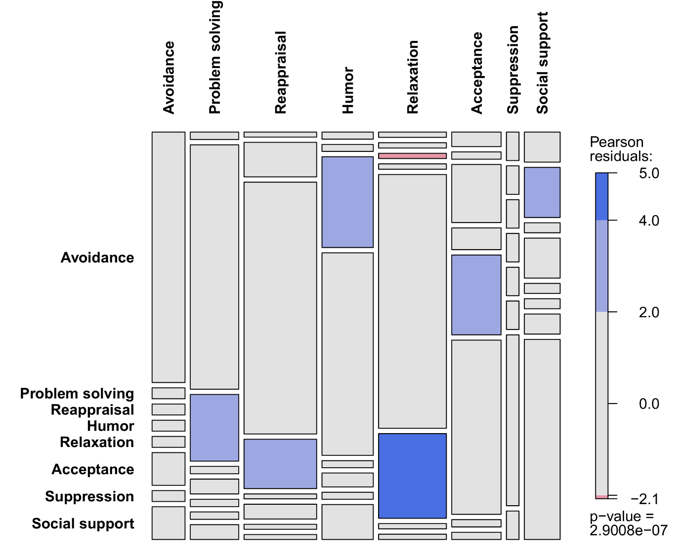
Quasi-independence
A significant test of quasi-independence can be followed with a residual analysis, to see which cells had larger or smaller counts than expected.
The square.tests function stores this information in its output, which can be plugged into a mosaic plot for visual inspection.
out <- square.tests(regul)
mosaic(regul+1,shade=TRUE,
expected=out$Fitted$Qindependence+1,
df=41)
This confirms more or less our descriptive expectations of important confusion patterns.

Slide 15
Symmetry and quasi-symmetry
While a test of quasi-independence can tell us if there are specific confusion patterns, it does not tell us if there is a significant direction to the confusions. This question addresses the null hypothesis of symmetry.
This can be tested by fitting a loglinear model in which mirroring off-diagonal cells are constrained to be equal. For the regulation data, we get a non-significant test:
Note however that symmetry implies marginal homogeneity. We can also construct a test that removes this constraint, which is known as quasi-symmetry. Its primary use is for constructing the marginal homogeneity test for A × A tables, since we can do this by a formal comparison of the symmetry and quasi-symmetry models.
Test LRT DF P
1 Independence 719.817400 49 0.000000e+00
2 Quasi-independence 157.746720 41 1.332268e-15
3 Symmetry 10.188428 28 9.991678e-01
4 Quasi-symmetry 4.596438 21 9.999346e-01
5 Marginal homogeneity 5.591991 7 5.881125e-01

Slide 16
Stratification
The preceding tests could also be extended to scenarios where confusion matrices are stratified across K independent groups. However, this requires further customization such that the third variable is added to the log-linear models for quasi-independence, symmetry, and quasi-symmetry.
Once the model is fitted, the three-way interaction K × A × A will test whether the A × A distribution differs significantly between the K groups. This is in fact a very general (even vague) test, which could then be followed up with tests for paired categorical data on the A × A matrix for each group separately.
Such tests could be of interest for studies that investigate determinants of confusions. For example, an emotion perception study could ask participants to classify stimuli into 10 emotion categories. One group hears voice samples, another facial expressions, and another body postures (=modality [voice,face,body]). Researchers may want to test the hypothesis that the stimulus modality modifies the confusion patterns.
Note that this approach requires independent groups, hence between-subjects strata!

Slide 17


Marginal homogeneity
Quasi-symmetry

Slide 18
Model performance
Finally, we return briefly to our logistic regression model for Game of Thrones deaths. We now have an extended toolbox for quantifying the goodness-of-fit of the model:
got <- array(c(11,54,11,132),dim=c(2,2),dimnames=
list(Observed=c("No","Yes"),
Predicted=c("No","Yes")))
square.tests(got)
CohenKappa(got,conf.level=0.95)
So poor agreement between predicted and observed outcomes, with a low Kappa value, marginal homogeneity rejected, and even a non-significant chi-square test!
 | Observed
Predicted | No | Yes
No | 11 | 11 | 22
Yes | 54 | 132 | 186
 | 65 | 143
Test LRT DF P
1 Independence 3.765678e+00 1 5.231465e-02
2 Quasi-independence 8.881784e-16 0 0.000000e+00
3 Symmetry 3.100276e+01 1 2.576616e-08
4 Quasi-symmetry -6.661338e-16 0 1.000000e+00
5 Marginal homogeneity 3.100276e+01 1 2.576616e-08
kappa lwr.ci upr.ci
0.112627986 -0.009337359 0.234593331

Slide 19
Thank you for your attention…!

