Slide 1
Global Governance VII *** Simulation of negotiations on nuclear disarmament issues
Autumn semester 2015
Prof. Micheline Calmy-Rey

Slide 2
Séquence vidéo: ouverture de la simulation

Slide 3
1.1. Why a simulation?
Simulation exercises have proven to be a valuable teaching method for familiarizing students with the workings of multilateral fora and international negotiation dynamics.
Geneva as a hub for multilateral negotiations is particularly well placed to conduct such simulation exercises.

Slide 4
1.2. Why a simulation on nuclear disarmament issues?
Political and economic centers of gravity are shifting; new players have emerged on the international stage. International organizations struggle to define and promote the type of policy that is needed to meet the challenges of a globalized and interdependent world.
Against this backdrop, the negotiations in the Conference on Disarmament (CD), which have been blocked for 19 years, and the workings of the Conference are interesting to study. First, because the stalemate in the CD is bad news for “International Geneva”, secondly, because it illustrates the difficulties of the United Nations collective security system established in the aftermath of the Second World War.
Established in 1979 as a single multilateral disarmament negotiation forum, the Conference counts 65 member states. The negotiation simulation addresses the following questions: What are the reasons for the stalled negotiations on disarmament? Which negotiation strategies can we observe? Are there any concrete proposals to unblock the negotiations? Why do they fail? What international standards are there in the field of disarmament? And what interferences can we observe between these standards and the negotiations? How and to which extent can we draw scientific conclusions from the instrument of negotiation simulations?
The simulation exercise thus aims at analyzing and elaborating new approaches to the non-proliferation and disarmament conundrum.

Slide 5
1.3. Roles
Head of Delegation: speaks on behalf of his/her delegation; is responsible for the coordination of his/her delegation
Assistant: assists his/her Head of Delegation in the preparation of the mandate & negotiation strategy; ad hoc research during the simulation; reaches out to other delegations to form alliances
Advisor: advises the delegation in terms of negotiation strategy and technical issues
Note taker: takes the minutes for the delegation
Observer: observes the negotiation strategy of the delegation, identifies the different negotiation phases and if need be, supports the delegation at the negotiation table

Slide 6
1.4. Rules of the game
Delegations are free to organize themselves. They may pause negotiations at any time in order to pursue discussions in smaller groups, they decide who speaks, they distribute the roles among their members.
Delegations negotiate and try to find solutions in the framework of their country’s mandate. If not possible, they try to advance solution proposals that are as closely oriented as possible towards their given mandate. The delegations take into account the other negotiator’s positions.
At the end of the simulation exercise, each delegation prepares a final statement, drafts a short report for its capital and prepares a press release analyzing the results of the exercise.

Slide 7
1.4.1. Rules of the game
Chatham House Rule
The Chatham House Rule applies to the entirety of the event:
“When a meeting, or part thereof, is held under the Chatham House Rule, participants are free to use the information received, but neither the identity nor the affiliation of the speaker(s), nor that of any other participant, may be revealed".
https://www.chathamhouse.org/about/chatham-houserule/translations#sthash.llHsTBms.dpuf

Slide 8
2. Negotiation method:
Diplomatic Engineering
Cf. Micheline Calmy-Rey, La Suisse que je souhaite, Lausanne: Editions Favre, 2014, pp. 120-125.
See also « Negotiation engineering » cf. Chair of Negotiation and Conflict Management (NECOM), Department of Management, Technology, and Economics, ETH Zurich

Slide 9
2.1. Diplomatic Engineering
Definition
Process-based approach to split a complex negotiation problem in precise (technical) sub-problems
Application of technical knowledge and objective criteria to solve the sub-problems.

Slide 10
2.2. Diplomatic Engineering
Process
Analyse the problem thoroughly and in its entirety (political, economic and technical aspects), understand the priorities and goals of all parties to the negotiation; focus on interests not on positions;
Think of a « win-win » solution: be creative
Put together a team: consult with technical experts etc.; all members of your delegation have a role to play
Create a space for rational dialogue: Based on a rational analysis of the problem in its entirety, (realistic) key objectives are identified. We then try to split the problem into sub-problems to reduce the complexity of the issue. Sub-problems are, as far as possible, reduced to the technical level.
Technical knowledge and objective criteria are applied to progressively solve the sub-problems.
Make the problem manageable by concentrating on precise sub-issues and try to depoliticize it

Slide 11
2.3. Diplomatic engineering
Case study: nuclear disarmament
Identify options for the various technical “definitions”;
Focus on those relevant “non-political” factors” that could help in the assessment of such options;
Assess each option from a consistent set of characteristics.
Cf. Bruno Pellaud, former Deputy Director General of the IAEA Department of Safeguards (please see slides 32-54: diplomatic engineering applied to a FMCT)

Slide 12
3. NEGOTIATION SCENARII
3.1. Fissile Material Cut-off Treaty (FMCT)
3.2. Humanitarian Approach (HA)

Slide 13
3.1. FMCT
Scenario A
Different players, same representatives (i.e. States)
Same topic: FMCT
Same set-up: CD
Table A: FMCT
Real CD
*as reference
Table A
*simulation of real CD
Comparison:
Real CD and Simulated CD

Slide 14
3.1.1. FMCT – Composition of the negotiation table
Pakistan
India
France
Russian Federation
United States
Japan
Brazil
Republic of Korea
Australia
Switzerland
Co-Chairs (Nigeria): Ambassador Luzius Wasescha, former Permanent Representative of Switzerland to the WTO, and Ms Angela Kane, UN High Representative for Disarmament Affairs (2012-2015).
Experts: Marc Finaud, GCSP, and Pavel Podvig, UNIDIR.

Slide 15
3.1.2. FMCT – General statements
Séquence vidéo: opening statements FMCT

Slide 16
3.1.3. FMCT - Overall goal
a) Deblock the Conference on Disarmament to make
negotiations possible
b) Achieve some progress on technical aspects:
Definition of «fissile material»
Verification of production
Definition of stocks

Slide 17
3.1.4. FMCT - Pre-negotiations
How to deblock the CD?
Issues to be resolved before the start of the simulation:
Rules of procedure (RoP) of the CD
Programme of work (PoW)
Shannon mandate (CD/1299; 1995)
Regional approach

Slide 18
3.1.5. FMCT – Pre-negotiations
How to deblock the CD? - RoP
a) Rules of procedure (adopted)
Chair: permanent Chair during the entire simulation exercise
The consensus rule is maintained; consensus does not necessarily mean that you fully agree but that you can live with the proposal and thus do not object to its adoption

Slide 19
3.1.6. FMCT – Pre-negotiations
How to deblock the CD? - PoW
b) Programme of work (PoW) (adopted)
Issue to be resolved: you cannot start negotiations on a FMCT without discussing the other issues on the agenda of the CD (« package deal »)
Proposal by Switzerland as amended by the Chair (adopted):
Return to past practice; the PoW is a simple schedule of activities without negotiating mandate (art. 28 Rules of procedure (RoP)). We assume that all four agenda items are discussed during the same session but at different negotiation tables. This puts all agenda items on equal foot. Then, see how far discussions can go with the fissile material issue given that the CD has a general negotiating mandate (art. 1 RoP). Already accomplished work on the fissile material issue may be considered as appropriate.
Explanations by Switzerland
This is close to the proposal of the Mexican presidency of the CD (Jan-Feb 2015) in the sense that it simplifies the PoW and puts all agenda items on equal foot - all agenda items need to be dealt with and, given that the CD has a negotiating mandate, will go as far as the discussions/pre-negotiations/negotiations permit it. This should allow to address the priority divergence among Member States. But it's not the Mexican proposal because this one remained too close to the practice that articulates a specific mandate to all the agenda items with negotiations on one and vague consideration on another - by articulating a negotiating mandate quite precise on all agenda items, this proposal was of course to frighten States with important concerns on some of them.
In our proposal, negotiations could take place even without a specific mandate on fissile material and the negotiations themselves would show what some States are ready to include in the treaty or not - but at least some kind of negotiations or pre-negotiations would take place. This, in the end, is negotiating the scope and definitions of the treaty. It also touches upon verification.

Slide 20
3.1.7. FMCT – Pre-negotiations
How to deblock the CD? - PoW
Programme of work for the 2015-2016 session
In order to carry the above mentioned negotiations and in accordance with rules of procedure 20, 28 and 29, and irrespective of the work of any Ad Hoc Committees established by the Conference, the Conference on Disarmament agrees to hold plenary sessions according to the following schedule:
First Part:
[President: Nigeria]
26 November Statements in plenary meetings. Consideration of the agenda and programme of work
26-27 November Agenda item 1 entitled "cessation of the nuclear arms race and nuclear disarmament“
26-27 November Agenda item 2 entitled "prevention of nuclear war, including all related matters"
[President: Nigeria]
18-31 January Statements in plenary meetings. Consideration of the agenda and programme of work
1-5 February Agenda item 2 entitled "prevention of nuclear war, including all related matters"
8-12 February Agenda item 2 entitled "prevention of nuclear war, including all related matters"
[President: Norway]
15-19 February Agenda item 3 entitled "prevention of an arms race in outer space"
22-26 February Agenda item 3 entitled "prevention of an arms race in outer space"
29 February-4 March Agenda item 4 entitled "effective international arrangements to assure non-nuclear-weapon States against the use or threat of use of nuclear weapons
7-11 March Agenda item 4 entitled "effective international arrangements to assure non-nuclear-weapon States against the use or threat of use of nuclear weapons
[President: Pakistan]
14-18 March Agenda item 5 entitled "new types of weapons of mass destruction and new systems of such weapons; radiological weapons"
21-24 March Agenda item 5 entitled "new types of weapons of mass destruction and new systems of such weapons; radiological weapons"

Slide 21
3.1.8. FMCT – Pre-negotiations
How to deblock the CD? - PoW
Second Part:
17-20 May Agenda item 1 entitled "Cessation of the nuclear arms race and nuclear disarmament"
30 May-3 June Agenda item 1 entitled "Cessation of the nuclear arms race and nuclear disarmament"
[President: Peru]
6-10 June Agenda item 6, entitled "comprehensive programme of disarmament"
13-17 June Agenda item 6, entitled "comprehensive programme of disarmament"
20-24 June Further consideration of outstanding matters
27 June-1 July Further consideration of outstanding matters
[President: Poland]
4-8 July Agenda item 7, entitled "transparency in armament«
Third Part:
2-5 August Further consideration of outstanding matters
8-12 August Agenda item 7, entitled "transparency in armament"
15-19 August Further consideration of outstanding matters
[President: Republic of Korea]
22-26 August Further consideration of outstanding matters
29 August-2 September Final statements, and consideration and adoption of Report
5-9 September Final statements, and consideration and adoption of Report
12-16 September Final statements, and consideration and adoption of Report

Slide 22
3.1.9. FMCT - Pre-negotiations
How to deblock the CD? - Shannon
c) Shannon Mandate
The Conference on Disarmament decides to establish an Ad Hoc Committee on a "ban on the production of fissile material for nuclear weapons or other nuclear explosive devices".
The Conference directs the Ad Hoc Committee to negotiate a non-discriminatory, multilateral and internationally and effectively verifiable treaty banning the production of fissile material for nuclear weapons or other nuclear explosive devices.
The Ad Hoc Committee will report to the Conference on Disarmament on the progress of its work before the conclusion of the 1995 session
During the course of my consultations, many delegations expressed concerns about a variety of issues relating to fissile material, including the appropriate scope of the Convention.
Some delegations expressed the view that this mandate would permit consideration in the Committee only of the future production of fissile material.
Other delegations were of the view that the mandate would permit consideration not only of future but also of past production. Still others were of the view that consideration should not only relate to production of fissile material (past or future) but also to other issues, such as the management of such material.
It has been agreed by delegations that the mandate for the establishment of the Ad Hoc Committee does not preclude any delegation from raising for consideration in the Ad Hoc Committee any of the above-noted issues.

Slide 23
3.1.10. FMCT – Pre-negotiations
How to deblock the CD? - Shannon
Question of interpretation
Proposal by France clarifying the Shannon mandate (adopted)
“Recalling its consensus to negotiate a treaty that should establish a legally binding, non-discriminatory, multilateral and internationally and effectively verifiable ban on the production of fissile material for nuclear weapons or other nuclear explosive devices, the Conference agrees that the report and mandate contained in document CD/1299 (1995) for that purpose will allow all delegations to discuss and decide […] on the possible modalities for addressing the issue of production of relevant fissile material prior to the entry into force of the Treaty as part of the definitions, scope and verification provisions of the Treaty or in separate instruments.”

Slide 24
3.1.11. FMCT – Pre-negotiations How to deblock the CD? - Shannon
Comments by an expert (Pavel Podvig)
Some may object an explicit reference to the existing stocks, but that's probably a matter of tweaking the language. If this helps Russia achieve its CD goal, which is to start discussion of [preventing an arms race in outer] space, it may be open to this.
Comments by an expert (Jelena Milenkovic):
This is a very good basis. I don't have a magic idea unfortunately but something along these lines is a good idea. Giving some space for protocols particularly might help. And discussing stocks in one way or the other - meaning, having them in the negotiations - does not mean the treaty will have to provide for the total elimination of all kinds of stocks.

Slide 25
3.1.12. FMCT – Pre-negotiations
How to deblock the CD? – Shannon
Ad Hoc Committee
Question of interpretation and on this basis, creation of an ad hoc committee:
Decision of the Conference on Disarmament on the establishment of an Ad Hoc Committee on a non-discriminatory, multilateral and internationally and effectively verifiable treaty banning the production of fissile material for nuclear weapons or other nuclear explosive devices. (ADOPTED)
Recalling its decision CD/2046 of 16 November 2015 on its programme of work and schedule of activities for its 2015-2016 session, and in particular paragraph 6 (a):
Under agenda item 1 entitled "cessation of the nuclear arms race and nuclear disarmament", to negotiate, with a view to reaching agreement on the basis of the report of the Special Coordinator (CD/1299) and the mandate contained therein as clarified by the Conference, on a non-discriminatory, multilateral and internationally and effectively verifiable treaty banning the production of fissile material for nuclear weapons or other nuclear explosive devices.
2. The Conference hereby establishes an Ad Hoc Committee to implement this decision.
3. This Ad Hoc Committee will commence its work immediately and will appoint its Chair who will report
to the Conference.

Slide 26
3.1.13. FMCT – Pre-negotiations
How to deblock the CD? - Shannon
Ad Hoc Committee
4. The Conference agrees that the report and mandate contained in document CD/1299 (1995) for that purpose will allow all delegations to discuss and decide on the possible modalities for addressing the issue of production of relevant fissile material prior to the entry into force of the Treaty as part of the definitions, scope and verification provisions of the Treaty or in separate instruments.
Explanation:
The adoption of the Shannon mandate as interpreted by the CD implies that an ad hoc committee is established by the Conference. Therefore, discussions on and negotiation of a FMCT take place within the setting of such an ad hoc committee.

Slide 27
3.1.14. FMCT – Pre-negotiations How to deblock the CD? - Regional
d) Regional approach (proposal by the Chair)
Comments by an expert (Marc Finaud)
This could be along the lines of the Brazilian idea for separate protocols attached to the main FMCT that would only contain general provisions. Regional states could negotiate more detailed arrangements, in particular on verification.
One model could be the Argentina-Brazil bilateral Nuclear Agency (http://www.abacc.org.br/?page_id=5&lang=en ) integrated into the Latin American Nuclear-Weapon Free Zone (see: http://www.nti.org/treaties-and-regimes/agency-prohibition-nuclear-weapons-latin-america-and-caribbean-opanal/ ).
There could be similar agencies (bilateral or regional) in the Middle East, South Asia, and the Korean Peninsula.
A parallel approach would be regional nuclear fuel banks for ensuring supply to civilian nuclear activities under international control such as the one recently opened in Kazakhstan with the support of the IAEA (see: www.iaea.org/ourwork/leubank ).
Comment by Micheline Calmy-Rey
The regional approach could define the basic principles of a FMCT at the global level; the modalities of implementation could subsequently be agreed upon at the regional level.

Slide 28
3.1.15. FMCT – Negotiation
We work on the basis of our «Programme of work»
Exactly the same as a real meeting:
The rules of procedure of the CD apply (available on dropbox https://www.dropbox.com/sh/02cog1xkg3xrsny/AABphaLVUfXD8CLB4ZPzhBq2a?dl=0 )
Confirmation of the Chair
Adoption of the Agenda (cf. slide 3.1.16)
General exchange of views (prepare statements)
Presentation of the draft treaty prepared by the Chair
Informal discussions
Negotiations

Slide 29
3.1.16. FMCT- Negotiation
Draft agenda of the ad hoc committee
Thursday
Morning
1. Opening of the meeting.
2. Confirmation of the Chair.
3. Statement by the Chair.
4. Adoption of the agenda.
5. Organization of work
6. General exchange of views.
Afternoon
7. Presentation of the draft treaty prepared by the Chair.
8. Informal discussion
9. Negotiations
Friday
Morning
9. Negotiations
Afternoon
10. Consideration and adoption of the
final documents of the meeting.
11. Other matters
Saturday
Meeting continued if needed.

Slide 30
3.1.17. FMCT – Negotiation
A draft treaty was circulated to students two days before the simulation exercise
(available on dropbox, https://www.dropbox.com/sh/02cog1xkg3xrsny/AABphaLVUfXD8CLB4ZPzhBq2a?dl=0)

Slide 31
3.1.18. Negotiation: treaty elements
3 sub-problems: definitions, verification, stocks
Definitions
- What is “fissile material”?
Verification of production
- What kind of fissile material production facilities should be verified?
Stocks
- What materials and components should be included under stocks?

Slide 32
3.1.19. Negotiation: What does “fissile material” mean?*
Which technological criteria should be used to determine which materials are within the scope of the treaty and therefore banned?
Is any mixture containing traces of uranium-233, uranium-235, plutonium-239 or neptunium-237 to be considered “fissile”, simply because physical or chemical processing could ultimately lead to weapon-grade levels and thus be labelled “weapon-usable”?
Or should it be only the best quality weapon-grade material with more than 90% uranium-235 or plutomium-239? If not, from which intermediate stage should the treaty apply?
*the following slides were kindly provided by Bruno Pellaud, former Deputy Director General of the IAEA Department of Safeguards

Slide 33
3.1.20. Negotiation: What does “fissile material” mean?
The NPT-IAEA option
Proponents of a strong FMCT recommend a verification system that leans as closely as possible on the NPT-IAEA safeguards model. They want the adoption of existing IAEA definitions, a model that would also simplify verification with a verification system that could be directly derived from IAEA practice.
Thus, fissile material would include: enriched uranium mixtures of all shades, as well as all plutonium mixtures (except those containing more than 80% plutonium-238); thorium because it could serve to produce the fissile uranium-233; neptunium-237 and odd-number americium isotopes, produced in very small quantities in the course of spent fuel chemical separation/reprocessing.
Notes:
Add « enriched »

Slide 34
3.1.21. Negotiation: What does “fissile material” mean?
Isotopic quality as technical inclusion criterion:
Option | Isotopic quality
1. NPT-IAEA | All uranium and all plutonium mixtures included - except if more than 80% Pu-238. Neptunium and americium included.
2. Australia | Same as NPT - except uranium below 20% [and americium].
3. Isotopic-A | Same as NPT - except uranium below 20%, recycled plutonium mixtures and americium.
4. Isotopic-B | Same as NPT - except uranium below 40%, recycled plutonium mixtures, high-burnup one-pass plutonium mixtures with more than 30% (Pu-238+Pu-240), and americium.
5. Russia revised | Included only HEU above 60% and plutonium with more than 60% Pu-239.
6. Russia | Included only HEU above 90% and plutonium with more than 90% Pu-239.

Slide 35
Options overview
3.1.22. Negotiation: What does “fissile material” mean?
Option | Obstacles to verifiability* | Confidentiality risks | Costs of verification
1. NPT-IAEA | High | Low | Very high
2. Australia | Medium | Low | High
3. Isotopic-A | Medium | Medium | High
4. Isotopic-B | Low | Medium | Low
5. Russia (revised) | Low | High | Medium
6. Russia | Very low | High | Medium
*Difficulty to access isotopic /material data; Complexity of isotopic mixtures

Slide 36
3.1.23. Negotiation: What does “production” mean?
Does “production” begin with:
the mechanical extraction of uranium ore from the ground,
or with the physical enrichment of uranium,
or with the mechanical fabrication of fresh fuel elements for nuclear reactors,
or with fuel burning in all kinds of nuclear reactors,
or only with the chemical separation of burnt fuel into its constituents, plutonium in particular?
Setting aside the stocks for a moment, the focus would thus be on verifying the production and not the products

Slide 37
Possible production start points
3.1.24. Negotiation: What does “production” mean?
Uranium*
Yellow cake
Enriching > 0.7%
Enriching > 5%
Enriching > 20%
Plutonium**
Irradiation of uranium
Handling of spent fuel
Reprocessing of spent fuel
*Comment: Today, the concern is not that HEU (enriched between 20 and 60%) be used in weapons, but that material enriched at more than 5% serves as feed to centrifuges for re-enriching rapidly and easily to levels above 90%)
**Comment: At the stages 1, 2 and 3, plutonium is mixed with fission products in
an “irradiated form”. Coming out of reprocessing, the plutonium is in a separated,
unirradiated form, a major transition in the successive production thresholds.

Slide 38
The NPT-IAEA option
3.1.25. Negotiation: What does “production” mean?
Proponents of a strong FMCT recommend a verification system that leans as closely as possible on the NPT-IAEA safeguards model. They want the adoption of existing IAEA definitions, a model that would also simplify verification with a verification system that could be directly derived from IAEA practice.
This would mean that production would cover the whole fuel cycle, from ore extraction and conversion to spent fuel handling and disposal.
From the previous threshold tables, this option takes Level One as starting point for both uranium and plutonium.

Slide 39
3.1.26. Negotiation: What does “production” mean?
Fuel cycle steps as technical inclusion criterion:
Option | Production thresholds
1. NPT-IAEA | Production would cover the whole fuel cycle, from ore extraction and conversion to spent fuel handling and disposal. Starting with yellow cake preparation for uranium, and starting with the effective production of plutonium in an operating reactor.
2. Geneva | For uranium, production would begin with enrichment activities above the natural level (0.7%). For plutonium, production would start with the removal from any reactor of any kind of spent fuel.
3. Australia | Production” would mean any enrichment (isotopic uranium separation) and reprocessing (separation of plutonium, uranium-233 and neptunium from irradiated material).
4. Australia+ | Production” would mean enrichment (isotopic uranium separation) above 5% and reprocessing (separation of plutonium, uranium-233 and neptunium from irradiated material).

Slide 40
3.1.27. Negotiation: What does “production” mean?
Options overview
Option | Obstacles to verifiability* | Confidentiality risks | Costs of verification
1. NPT-IAEA | Very High | Low | Very high
2. Geneva | High | Low | High
3. Australia | Medium | Medium | Medium
4. Australia+ | Low | Medium | Medium
*Difficulty to access facilities /material data; Complexity of facilities/processes

Slide 41
3.1.28. Negotiation: What does “production” mean?
 | Technical Exclusion Criteria
Model | None | Irradiation status | Isotopic quality
NPT-IAEA | Central criterion: No exclusion. All fuel cycle materials to be included. | No materials to be excluded, whether irradiated, unirradiated or separated. | No uranium mixtures to be excluded. No plutonium (Pu)mixtures excluded, except with more than 80% Pu-238
Australia | Double exclusion in an attempt to constrain complexity and costs | Central criterion: Exclusion of fissile materials mixed with a defined level of fission products | Only exclusions: Uranium below 20% and Plutonium mixtures with more than 80% Pu-238
Isotopic-A | Single exclusion in an attempt to constrain complexity and costs | No materials to be excluded, whether irradiated, unirradiated or separated, except those excluded because of their isotopic composition. | Central criterion: Excluded: HEU below 20% Excluded: two-pass Pu mixtures (MOX)
Russia (revised) | Double exclusion in an attempt to constrain drastically the complexity and the costs | Central criterion: Exclusion of fissile materials mixed with fission products (irradiated) | Central criterion: Excluded: HEU below 60% Plutonium with less than 60% Pu-239

Slide 42
3.1.29. Negotiation: Stocks Simulation 26-27 November 2015
séquence vidéo: discussion sur la question des stocks

Slide 43
3.1.30. Negotiation: Stocks
If stocks should come into the FMCT scope, then “What materials and components should be included under stocks”?
Beyond well-known “sensitive facilities”, which other facilities would be technically relevant under the FMCT?
If disposition of stocks comes into the scope, how should “disposition” be technically defined?

Slide 44
Potential categories of stocks
3.1.31. Negotiation: Stocks
Potential categories:
- deployed weapons, stockpiled weapons
stored weapon components (pits), at weapons stores;
stocks stored in bulk form (weapon mixtures) at fabrication plants or weapons stores);
stored in bulk form (pre-weapon powders separately, e.g. HEU, plutonium, gallium,…) in other less-sensitive facilities.

Slide 45
3.1.32. Negotiation: Stocks
 | Stock technical options
 | Bulk, non-sensitive mixtures, in cleared facilities | Bulk, sensitive mixtures, in weapons stores | Pits
Volume of material | Small | Medium | High
Number of locations | Few, even single per State | Several per State | Many per State
Complexity for verification | Low | Medium | High, since stored in active locations

Slide 46
3.1.33. Negotiation: Stocks
Options overview for stocks
Option | Ease of verifiability | Confidentiality risks | Costs of verification
1. Pits (Brazil in CD/1888)* | Medium | Low | Medium
2. Bulk, sensitive mixtures, in weapons stores** | Low | High | High
3. Bulk, non-sensitive mixtures, in cleared facilities | Medium | Medium | Medium
*Brazil CD/1888: “…… not contained in complete weapons”. Or after dismantlement of the “physics package”?
**Stocks would be scattered on various military sites, with difficult access problems for international inspectors.

Slide 47
“Effectively verifiable”??
3.1.34. Negotiation: Stocks
Shannon: … a treaty that would be “…. internationally and effectively verifiable”;
Effectively verifiable? That means a treaty conceived in terms of scope and technical definitions to make possible an effective verification by an international inspectorate? or…
Effectively verified? As interpreted by many. In that case, reversely, the verification inspectorate would be mandated to verify effectively the scope and technical definitions enshrined in the treaty, whatever they are.

Slide 48
Disposition of unused fissile material
3.1.35. Negotiation: Stocks
If disposition of stocks comes into the scope, how should “disposition” be technically defined?
Action 16 of the Fissile Material section of the RCNPT Final Declaration states that “The nuclear-weapon States are encouraged to commit …. to (define) arrangements for the disposition of such material for peaceful purposes, to ensure that such material remains permanently outside military programmes”.
For example, the FMCT could deal with this matter by specifying time limits for the disposition of fissile material towards civilian uses or towards destruction, or by stipulating reporting mechanisms as to the disposition schemes.
In other words, the treaty could conceivably include built-in mechanisms for stockpile disposition, a clear disarmament undertaking, with a positive drive towards reductions of the amount of military material.

Slide 49
Disposition and irreversibly
3.1.36. Negotiation: Stocks
Disposition of fissile material should be irreversible
Irreversible step—or process, or change—is one that is inherently irrevocable, one that entails no possibility of reverting to the prior position or original state of being.
Irreversibly should preferably be achieved through intrinsic, technical means rather than by extrinsic, institutional or legal measures

Slide 50
Disposition: technical options
3.1.37. Negotiation: Stocks
For uranium: down blending of HEU to LEU for use in nuclear power plant, as currently done with unused Russian HEU stocks, in particular under the Megatons to Megawatts programme with the US;
For plutonium: fabrication into weapon-grade (WG) MOX fuel for burning in dedicated nuclear power plants in the State itself;
For plutonium: dilution of WG plutonium with the out-stream of a civilian reprocessing facility and subsequent fabrication into regular MOX fuel for burning in any nuclear power plant anywhere.
For plutonium: immobilisation in some form such as vitrified glass, mixed with appropriate poisons, for subsequent geological disposal.

Slide 51
3.1.38. Negotiation: Stocks
Options overview for disposition
Option | Ease of verifiability | Confidentiality risks | Costs of verification
1. HEU downblending | High | Low | Low
2. WG Pu: direct burning in dedicated reactors | Medium | Medium | Medium
3. WG Pu diluted to RG, then burnt in any reactor | High | Low | Low
4. Immobilisation in glass, then geological disposal | High | Low | Low

Slide 52
“Non-proscribed activities” ?
3.1.39. Negotiation: Stocks
States with naval reactors regard the design of naval fuel, and factors such as core loadings and range between refuelling, as highly classified. High HEU is best fuel, but 20% is possible.
Some NWS operate naval reactors with highly enriched uranium fuel (HEU), so they wish HEU production to continue under the FMCT for this purpose.
A few NNWS had at time expressed an interest for nuclear naval propulsion, causing the IAEA to look at the matter. The IAEA arrangements would allow a NNWS to temporarily remove nuclear material (LEU or HEU) from safeguards.
Similar verification arrangements for the naval fuel cycle in NWS could be identified.

Slide 53
Options for non-proscribed activities
3.1.40. Negotiation: Stocks
Choice of a HEU threshold for the FMCT: 20%. Then:
If no allowed production above threshold: run-down of higher HEU levels (disposition) and use of naval fuel below threshold;
If continuing production, then under strict verification;
If further use of HEU for non-proscribed military activities: Arrangements to allow a State to temporarily remove nuclear material from verification (IAEA).

Slide 54
Beyond “sensitive facilities”, which other facilities are technically relevant for a FMCT?
3.1.41. Negotiation: Stocks
Facility coverage is determined essentially by the chosen definition of fissile material and definition of production. As a rule: facilities should be included in which such fissile material are present or can be produced, whatever the chosen definitions. Each of the possible combinations of fissile material and production options discussed previously will have its own list of relevant facilities.
For example, in the case of the Australian model, the coverage will include all enrichment and reprocessing facilities, whether military or civilian, whether they contain or not the corresponding fissile material. Nuclear power plants would not be in the list, as well as their associated fresh fuel facilities and spent fuel stores.
Therefore, here, all options are determined indirectly.

Slide 55
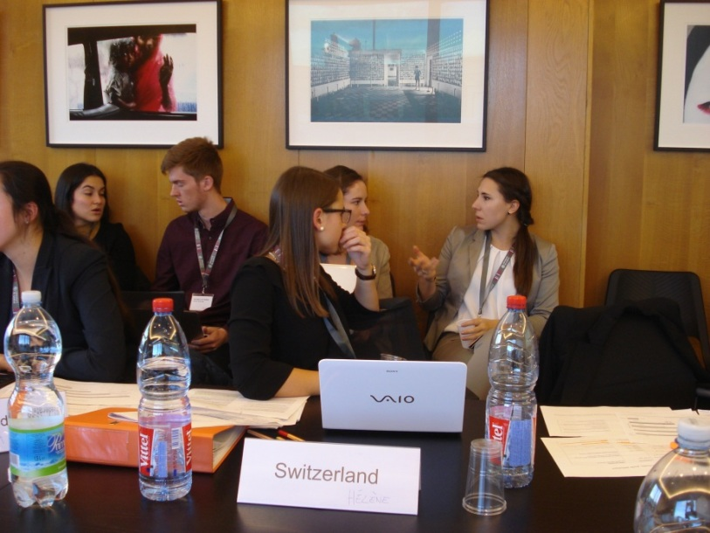
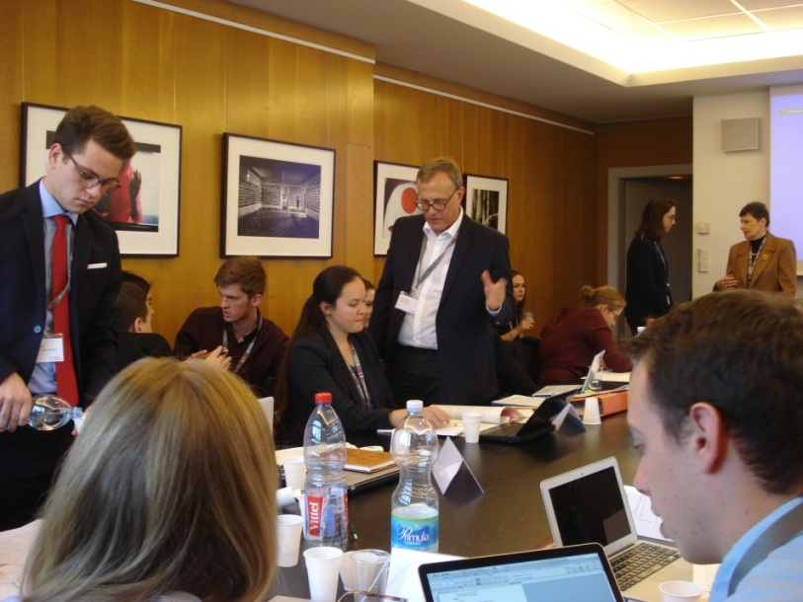
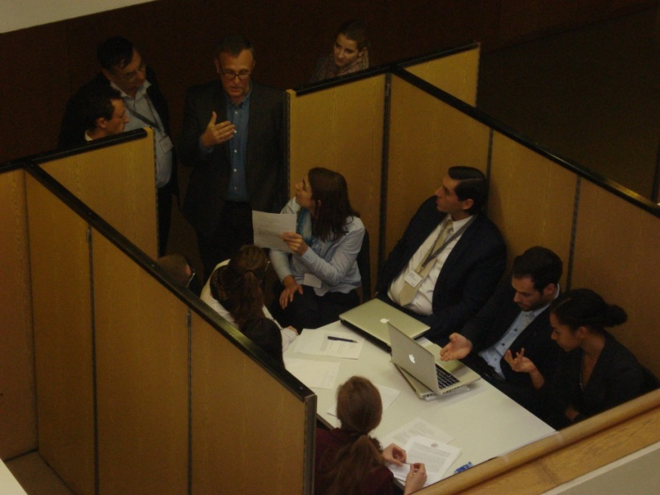
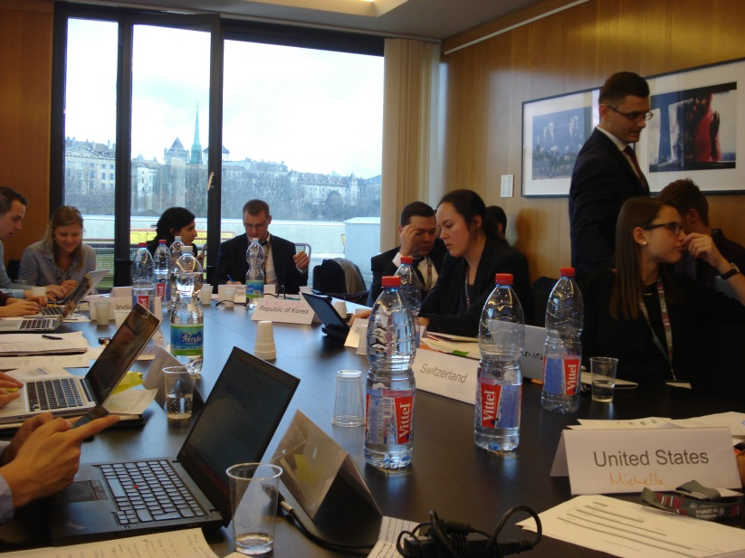
3.1.42. FMCT – Negotiation
26-27 November 2015

Slide 56
3.1.43. FMCT – Negotiation
26-27 November 2015
Séquence vidéo: impressions de la simulation

Slide 57
3.1.44. FMCT – Negotiation outcome
*text negotiated by the students during the simulation
** text not negotiated due to limited time
The entire treaty is available on dropbox, https://www.dropbox.com/sh/02cog1xkg3xrsny/AABphaLVUfXD8CLB4ZPzhBq2a?dl=0

Slide 58
3.1.45. FMCT – Negotiation outcome
Article I: Basic Undertakings – Object and Purpose
I.1. States commit not to increase their nuclear weapon arsenals.
I.2. Each State Party to this Treaty undertakes, from the date of entry into force of the Treaty for it, not to produce any fissile material for nuclear weapons or other nuclear explosive devices.
Comments
It is not about reducing the production of fissile material for nuclear weapons use and other explosive devices but about not to increase nuclear weapon arsenals and to stop producing any fissile material from the date of entry into force of the Treaty.
Article II: Definitions
II.1. For the purposes of this Treaty: “fissile material” means:
a) Uranium enriched to 20% or more isotope 235 or 233;
b) Separated plutonium with any isotopic composition;
c) Any unirradiated material containing the materials defined in a) or b).
II.2. For the purposes of this Treaty “production facilities” are defined as all facilities capable of producing fissile material as defined in article II.1. Laboratory scale facilities under established practice are excluded.
Comments
The definition of fissile material is key. It has also been agreed that the definition and the verification mechanism are interrelated and should take into account the use of material for non-explosive purposes. The definition adopted is based on the definition provided by the IAEA.
The definition of production facilities, excluding laboratory scale facilities, is neither too narrow nor too broad. It avoids fixing “significant quantities of fissile material to be defined on a national basis“ which is ambiguous and might be discriminatory.

Slide 59
3.1.46. FMCT – Negotiation outcome
Article III: Verification
III.1. The IAEA is responsible for verification on the basis of modalities included in the verification annex.
III.2. Every production facility as defined in article II.2. is subject to verification on a regular basis.
III.3. Any fissile material as defined in article II.1. that is produced from the day after the entry into force of this treaty may not go into nuclear weapons and other nuclear explosive devices are subject to verification.
III.4. Fissile material as defined in article II.1. produced for non-proscribed military uses shall be under verification of the IAEA, under a special verification regime (black box approach) to ensure that materials are not diverted to nuclear weapons or nuclear explosive devices.
There shall be assurance provided by the responsible state that material used as specified shall not be diverted.
III.5. Clarification procedure: Where there is serious concern regarding a State Party’s compliance with its basic obligations under this Treaty, the Technical Secretariat and the State Party concerned shall consult together immediately. Following those consultations, the Director-General, on the basis of the information gathered by the Secretariat, may request the State Party concerned, independently of any recourse to dispute settlement procedures, to provide clarifications or take promptly any other measures that may be necessary to clarify the situation and facilitate its resolution. The Director-General shall inform the Executive Council accordingly.
Comments
A verification mechanism has to deal with detection and deterrence, assuring that cases of non-compliance are resolved while security interests and sensitive information are protected. An article was added on fissile material produced for non-proscribed military uses, e.g. by the naval industry. This material will be under a special verification regime (black box approach) to ensure that it is not diverted to nuclear weapons nor to nuclear explosive devices.

Slide 60
3.1.47. FMCT – Negotiation outcome
III.6.
a) State parties to this treaty shall have the right to challenge the purpose of any facility in the territory of another state. If the accusations are found to be credible by the IAEA, the challenged state is hereby asked to look favorably upon an inspection by the IAEA in an effort to settle the challenge.
b) This challenge clause shall include a managed access which means the inspection team shall take into consideration suggested modifications of the inspection plan and proposals which may be made by the inspected State Party, at whatever stage of the inspection, to ensure that sensitive equipment, information or areas, are protected.
Comments
A challenge mechanism was included in the verification provisions. State parties to this treaty will have the right to challenge the purpose of any facility in the territory of another state. Accusations will always be considered by the IAEA and the challenged state will be asked to accept an inspection by the IAEA in an effort to settle the challenge.
Article IV: Confidentiality
Verification activities shall be carried out so as to be compatible with the following requirements:
a) The need to prevent the transfer or acquisition of information that is sensitive from the point of view of the proliferation of nuclear weapons;
b) The preservation of the security interests of the States Parties;
c) The protection of industrial, technological and commercial secrets.

Slide 61
3.1.48. FMCT – Negotiation outcome
Article V: Declarations
States declare material in excess of weapons needs. A state should make a declaration and the material would irreversibly be made subject to appropriate treaty verification. This verification is on the basis of modalities included in the verification annex which is to be negotiated at a later stage.
Comments
It was considered how and which categories of stocks should be covered by the treaty in order to avoid time-consuming and abstract political discussion of whether or not to include existing stocks. Discussions showed that the goal of dealing with existing stocks is to ensure their non-diversion to nuclear weapons use. With flexibility of the American, Russian and Indian delegations it was possible to include a paragraph stating that States declare materials in excess of weapons needs, which will be subject to verification.

Slide 62
3.1.49. FMCT – Negotiation outcome
Evaluation
The negotiation outcome is a “package deal”:
states that made concessions on stocks, USA, Russia, India, and with regard to the definition
of fissile material obtained in turn concessions from other states on the verification
mechanisms. An article was added about fissile material produced for non-proscribed
military use, stating that this material would be under a special verification regime (black box
approach) to ensure that it would not be diverted to nuclear weapons or nuclear
explosive devices.
The IAEA is the responsible organization for verification. However, the modalities of the verification procedures are to be defined in an technical annex which remains to be negotiated. This leaves the door open for further (technical) negotiation.
It was agreed that the verification procedure is divided into three types. Only the facilities declared by countries as capable of producing weapon-grade fissile material will be subject to the general regular verification. Other facilities will only be subject to verification under a challenge mechanism procedure. A special verification procedure (black box approach) will be applied to fissile material for non-subscribed military uses (inviolability of military secrets).

Slide 63
3.1.50. FMCT – Negotiation outcome
Evaluation
A clarification procedure was added to reassure states.
The question of stocks was treated in a creative way. The formula of “fissile material in excess to weapons needs” leaves room for interpretation and allows to take into account national security concerns. As verification modalities remain to be defined in an technical annex, this may help to depoliticize the question.
The diplomatic engineering approach allowed states to enter into technical discussions and to obtain progress on three aspects, definition of fissile material, verification of production and definition of stocks, which then served as a basis for a « package deal ». Thus, the technical discussions helped states to clarify their positions and to identify « offers» and « counter-offers ».

Slide 64
3.1.51. FMCT – Negotiation outcome
Overall evaluation by the experts
There was a clear willingness to seek compromise solutions.
The basic obligation provisions aim at reassuring states that, even if only future production of fissile material for nuclear weapons is banned, the existing stocks (past production) will not be used to increase the nuclear weapons arsenals. This should be acceptable to all nuclear armed states who agree on the goal of nuclear disarmament, and the contribution of an FMCT to that goal.
The definition retained for fissile material is the most realistic one (‘direct-use unirradiated material’), based on the IAEA definition.
The solution found for verification entrusts the IAEA but retains a role for FMCT institutions (Conference of States Parties, Executive Council, Secretariat).
A clarification procedure is added as intermediate between routine verification and challenge inspections.
A specific procedure for the verification of military non-proscribed uses (naval fuel) is advocated but referred to a technical annex to be negotiated.

Slide 65
3.1.52. FMCT – Negotiation outcome
Séquence vidéo: final statements FMCT

Slide 66
3. NEGOTIATION SCENARII
3.2. Humanitarian Approach (HA)

Slide 67
3.2.1. HA
Scenario B
Different representatives (States and stakeholders)
Same topic: ND
Different set-up: outside the CD, the rules of procedure are different
Table B: ND
Real CD
*as reference
Table B
* Simulation of alternative approach
Evaluation of the potential approaches (“step by step” and “alternative”)

Slide 68
3.2.2. HA – Composition of the negotiation table
Mexico
South Africa
Egypt
New Zealand
Indonesia
Denmark
Costa Rica
Germany
« Reaching Critical Will »
« International Campaign to Abolish Nuclear Weapons - ICAN »
Co-Chairs (Austria): Ambassador Jenö Staehelin, former Permanent Representative of Switzerland to the UN in New York, and Ambassador Peter Gottwald, former Ambassador of Germany to Switzerland.
Experts: Jelena Milenkovic, former Third Secretary, Permanent Mission of Switzerland to the United Nations Office in Geneva and Mia Gandenberger, Programme Manager, Reaching Critical Will.

Slide 69
3.2.3. HA – Overall goal
No pre-negotiations
Starting point: Humanitarian Pledge (endorsed by 121 countries; 15.11.2015)
Overall mandate: “To identify and pursue effective measures to fill the legal gap for the prohibition and elimination of nuclear weapons and to cooperate with all stakeholders to achieve this goal”.
Austria and Mexico invite to Mexico City to build on the three conferences on the Humanitarian Impact of Nuclear Weapons (cf. diplomatic note cf. slide 78). Austria will chair the meeting and the intention is to agree on a legal instrument on the prohibition of nuclear weapons.
We assume that the process takes the same path as the landmines and cluster munitions processes and that we are invited to the negotiating conference. We will work on the basis of our «Programme of work», exactly as if we were in an international conference, and, on the basis of the Rules of procedure that we will adopt, we will proceed to negotiations on the draft treaty, which will be submitted by the Chair, article by article.

Slide 70
3.2.4. HA – Opening of the Conference
Séquence vidéo: opening statements HA

Slide 71
3.2.5. HA - History
2010 NPT Review Conference Final Document:
“The Conference expresses its deep concern at the catastrophic humanitarian consequences of any use of nuclear weapons and reaffirms the need for all States at all times to comply with applicable international law, including international humanitarian law.”
(NPT/CONF.2010/50 (Vol. I), p. 19.)

Slide 72
3.2.6. HA – History Joint statements on the humanitarian impact of nuclear weapons

Slide 73
3.2.7. HA – History
Three conferences on the humanitarian impact of nuclear weapons with facts-based discussions on the short-term and long-term impacts of nuclear weapons (immediate effects but also longer term effects on health, environment, development, infrastructure, etc. ; capacity to respond; effects of nuclear weapon testings, etc.) :
4-5 March 2013 Oslo, Norway
13-14 February 2014 Nayarit, Mexico
8-9 December 2014 Vienna, Austria
–> « Humanitarian Pledge »

Slide 74
3.2.8. In the real world…
Unclear how states will take this forward.
At the United Nations General Assembly First Committee in October 2015 four new resolutions adopted that are derived from the humanitarian approach:
to establish an open-ended working group (OEWG) to meet in Geneva next year to discuss effective measures for nuclear disarmament.
on the humanitarian consequences of nuclear weapons,
on the humanitarian pledge for the prohibition and elimination of nuclear weapons, and
on the ethical imperatives for a nuclear weapon free world
Many possibilities remain, including «our scenario»

Slide 75
3.2.9. For the purposes of our simulation:
we assume that the process takes the same path as the landmines and cluster munitions processes:
3 international conferences on the facts
A pledge
An international conference to negotiate a treaty banning landmines/cluster munitions/nuclear weapons

Slide 76
3.2.10. HA - Starting point: Humanitarian Pledge (Extracts)
“In light of the important facts and findings that have been presented at the international conferences in Oslo, Nayarit and Vienna, and after careful consideration of the evidence, We, the States supporting and/or endorsing this pledge, have come to the following inescapable conclusions and make the subsequent pledge to take them forward with interested parties in available fora, including in the context of the NPT and its 2015 Review Conference. […]”

Slide 77
3.2.11. HA - Starting point: Humanitarian Pledge (Extracts)
“[…] We pledge to follow the imperative of human security for all and to promote the protection of civilians against risks stemming from nuclear weapons,
We call on all states parties to the NPT to renew their commitment to the urgent and full implementation of existing obligations under Article VI, and to this end, to identify and pursue effective measures to fill the legal gap for the prohibition and elimination of nuclear weapons and we pledge to cooperate with all stakeholders to achieve this goal, […]”
Taken from: http://reachingcriticalwill.org/images/documents/Disarmament-fora/vienna-2014/humanitarian-pledge.pdf

Slide 78
3.2.12. HA – Starting point
Diplomatic note by the Chair

Slide 79
3.2.13. HA - Negotiation
We work on the basis of our «Programme of work»
Exactly the same as a real conference:
Confirmation of the President
Adoption of the Rules of Procedure
(TBNWC/Draft.1/Rev.1; available on dropbox: https://www.dropbox.com/sh/02cog1xkg3xrsny/AABphaLVUfXD8CLB4ZPzhBq2a?dl=0 )
Adoption of the Agenda
General exchange of views (prepare statements)
Presentation of the draft treaty prepared by the Chair
Formal negotiations article by article

Slide 80
3.2.14. HA - Negotiation
Draft provisional agenda of the Conference
1. Opening of the Conference.
2. Confirmation of the President.
3. Statement by the President.
4. Adoption of the rules of procedure.
5. Adoption of the agenda.
6. Organization of work.
7. General exchange of views.
8. Presentation of the draft treaty prepared by the Chair (available at: https://www.dropbox.com/sh/02cog1xkg3xrsny/AABphaLVUfXD8CLB4ZPzhBq2a?dl=0)
9. Formal negotiations on
Principles/Preamble
Scope (including verification and elimination)
Entry into force
10. General exchange of views.
11. Consideration and adoption of the final documents of the Conference.
12. Other matters.

Slide 81
3.2.15. HA - Negotiation
Programme of work
Thursday
Morning
1. Opening of the Conference.
2. Confirmation of the President.
3. Statement by the President.
4. Adoption of the rules of procedure.
5. Adoption of the agenda.
6. Organization of work
7. General exchange of views.
Afternoon
8. Presentation of the draft treaty prepared by the Chair.
9. Formal negotiations on
Principles/Preamble
Scope (including verification and elimination)
Friday
Morning
9. Formal negotiations on
Scope (including verification and elimination)
Entry into force
Afternoon
10. General exchange of views.
11. Consideration and adoption of the
final documents of the Conference.
12. Other matters
Saturday
Meeting continued if needed.

Slide 82
3.2.16. HA - Negotiation
Séquence vidéo: impressions de la négociation

Slide 83
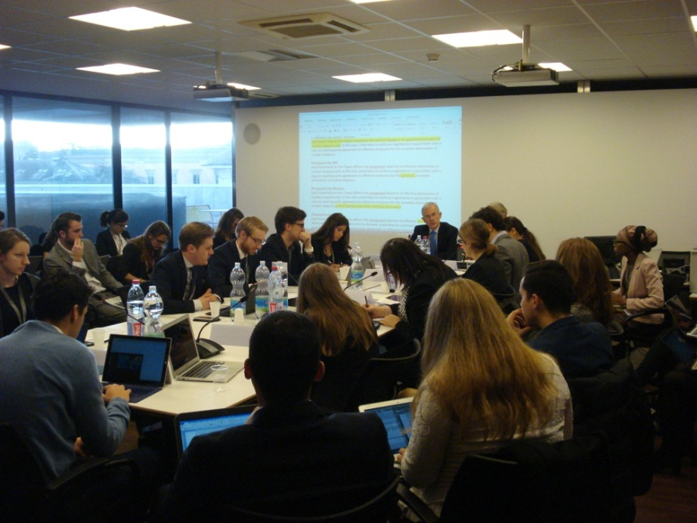
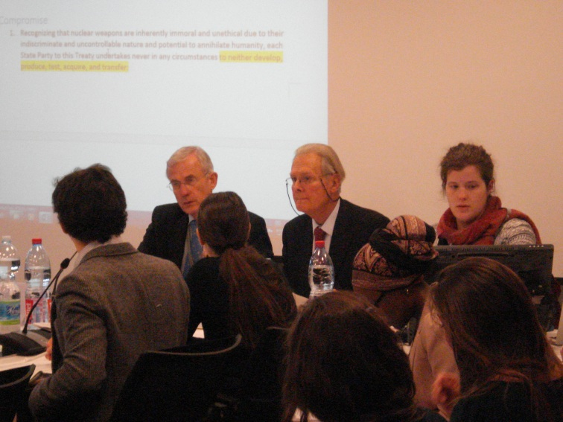
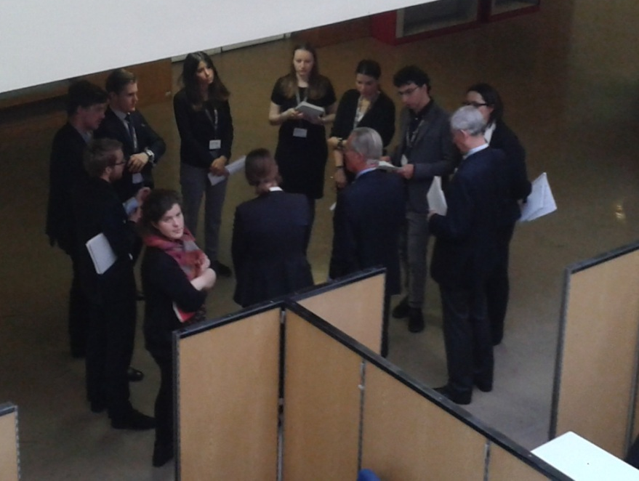
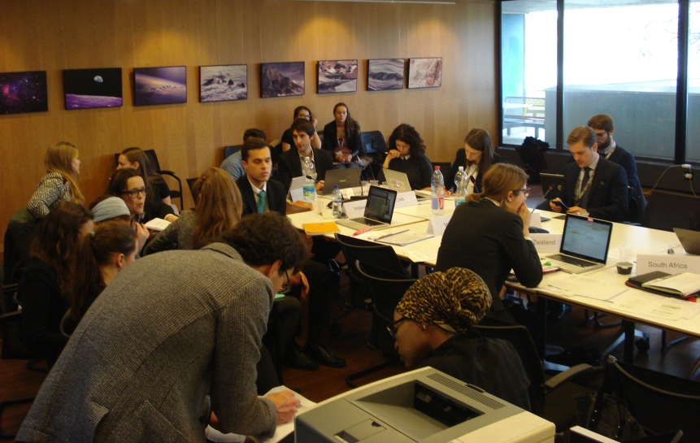
3.2.17. HA – Negotiation 26-27 November 2015

Slide 84
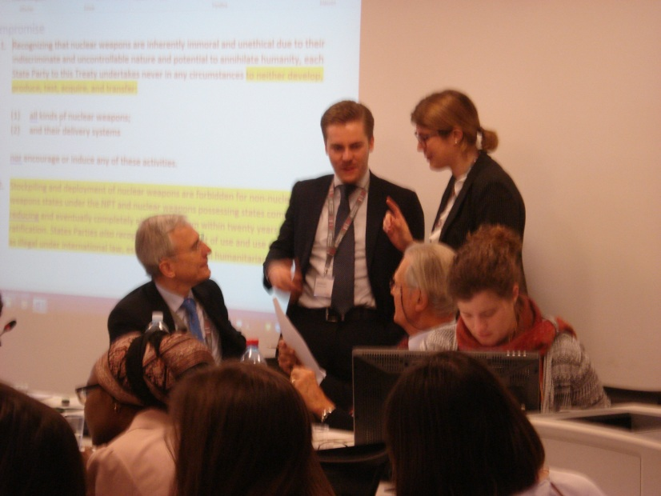
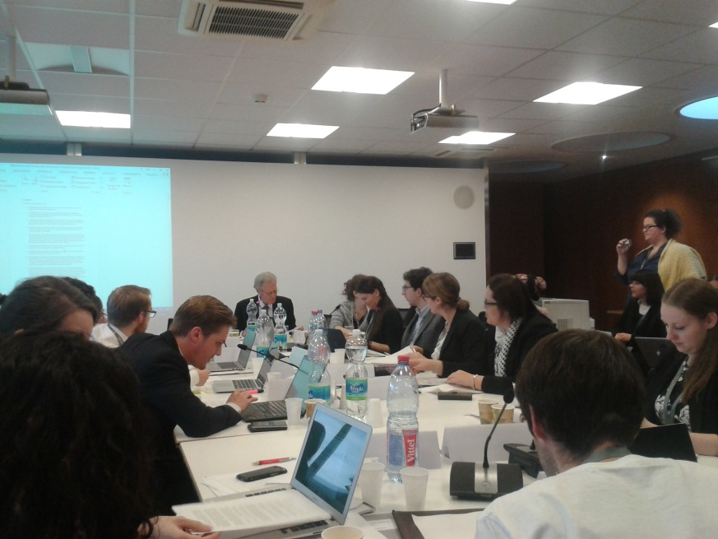
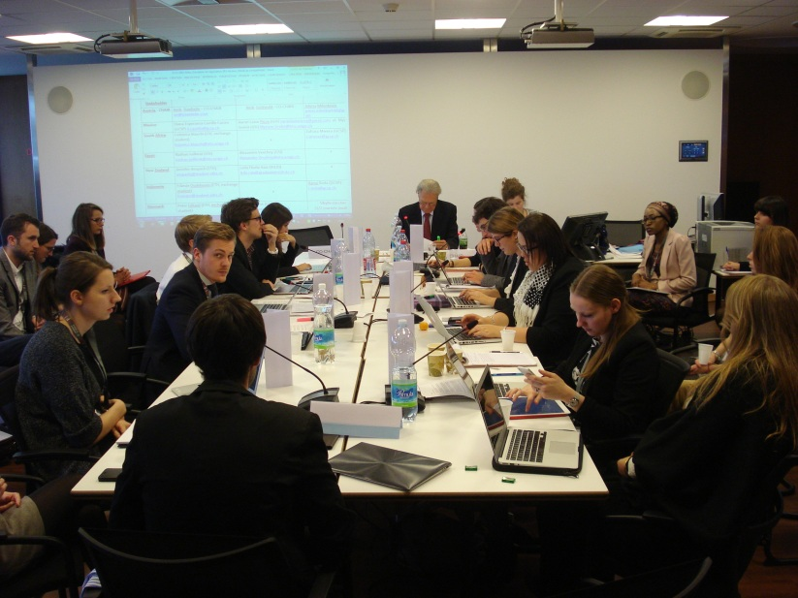
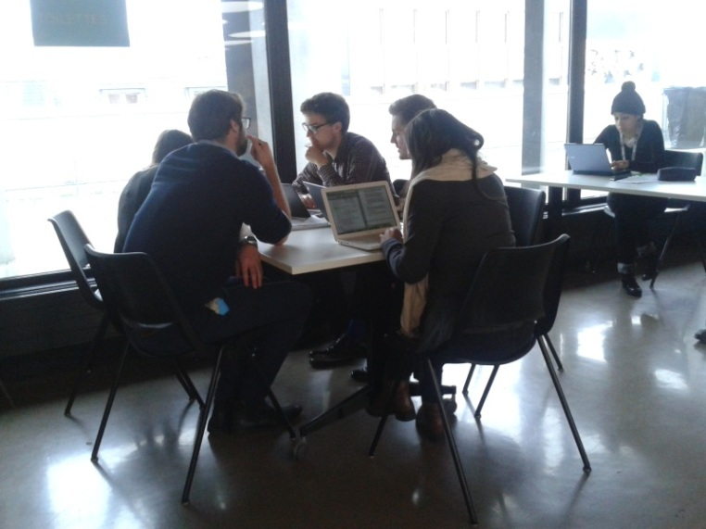
3.2.18. HA – Negotiation 26-27 November 2015

Slide 85
3.2.19. HA - Negotiation
Treaty elements
Negotiations on:
Principles/Preamble
Scope:
Ban on what?
Verification?
Elimination
Provisions on entry into force
Each article

Slide 86
3.2.20. HA - Negotiation Treaty elements
Scope
comprehensive ban/ban on: nuclear weapons on soil/territory/under jurisdiction - development, production, stockpiling, transfer, possession, use, threat of use, investment in
ban on certain types of NW: tactical/non-strategic, strategic, in storage
ban on NW using certain means of delivery (air/sea/land)
ban on certain means of delivery (air/sea/land)

Slide 87
3.2.21. HA - Negotiation Treaty elements
Verification
included: NPT IAEA regime for States parties to the treaty
included: new regime
not included

Slide 88
3.2.22. HA - Negotiation Treaty elements
Elimination
included: adapt security/military doctrines regarding nuclear weapons, dismantlement of retired warheads/active warheads, destruct dismantled warheads
not included

Slide 89
3.2.23. HA - Negotiation Treaty elements
Entry into force
50 states ratify
2/3 signatories ratify
2/3 member states of the UN ratify
List of certain states that need to ratify the treaty (ex. CTBT)

Slide 90
3.2.24. HA – Negotiation 26-27 November 2015
Séquence vidéo: adoption of the outcome document

Slide 91
3.2.25. HA – Negotiation outcome
The entire treaty is available on dropbox, https://www.dropbox.com/sh/02cog1xkg3xrsny/AABphaLVUfXD8CLB4ZPzhBq2a?dl=0

Slide 92
3.2.26. HA – Negotiation outcome
(extracts)
Article I
1. Recognizing that nuclear weapons are inherently immoral and unethical due to their indiscriminate and uncontrollable nature and potential to annihilate humanity, each State Party to this Treaty undertakes never in any circumstances to neither develop, produce, test, acquire, and transfer:
(1) all kinds of nuclear weapons;
(2) and their delivery systems
nor encourage or induce any of these activities.
2. States Parties also recognize that the threat of use and use are regarded as illegal under international law, especially international humanitarian law.
3. Stockpiling and deployment of nuclear weapons are forbidden for non-nuclear weapons states.
4. States possessing nuclear weapons acceding to this Treaty commit to reduce and eventually completely eliminate nuclear weapons within a timeframe to be set by each of them in agreement with the Conference of States Parties provided for in Article 8. Such timeframe shall be set at the latest within five years after the ratification of, or accession to, the Treaty by the State possessing nuclear weapons, and shall not exceed 30 years. If it becomes apparent to a State Party that it will not be able to meet the timeframe set, for practical reasons and despite its best efforts in good faith, it may submit a request to the Conference of State Parties for an extension of the deadline.

Slide 93
3.2.27. HA – Negotiation outcome
(extracts)
Article II
Nuclear weapon possessing states and states members of military alliances together with nuclear weapon possessing states may join the treaty provided that they do not put any reservations on any of the provisions of Article 1 and provided that they fully comply with these provisions.
[…]
Article VIII
1. One year after the entry into force of this Treaty, a conference of States Parties to the Treaty shall be held in Geneva, Switzerland, to review the operation of the Treaty, with a view to assuring that the purposes of the preamble and the provisions of the Treaty, including the provisions concerning negotiations on effective measures for the complete elimination of nuclear weapons, are being realised. Such a conference shall thereafter meet every year to review progress of the implementation.
2. States Parties of this Treaty are encouraged to discuss the further implementation of effective verification mechanisms to control the fulfilment of the agreements decided in the Treaty, in particular Article 1 and 2. This discussion will take place within the upcoming Conference of States Parties.

Slide 94
3.2.28. HA – Negotiation outcome
Evaluation
The treaty represents a compromise between the Group of 7 (South Africa, New Zealand, Indonesia, Austria, Costa Rica, Mexico and Egypt) and the Group of 2 (Denmark, Germany).
Main points of disagreement concerned Article I and II, in particular the ban of use and threat of use and the timeframe for elimination of nuclear weapons. The following compromises were reached in informal meetings:
Art. I: The use and threat of use are regarded as illegal under international law. This formulation leaves room for interpretation and therefore is flexible enough to allow NATO states to join the treaty.
Art. I.4 in combination with Art. VIII:
The complete elimination of nuclear weapons after ratification, within a timeframe decided individually by each state possessing these weapons acceding to this treaty. This timeframe must be set within 5 years after ratification and must not exceed 30 years. The timeframe can be extended under special circumstances, agreed upon in the Conference of State parties.
Thus, nuclear-weapon states can join the treaty as long as they subscribe to Art. I and agree to a deadline for the total elimination of their arsenal. This deadline can be further negotiated with the Conference of State parties.
The combination of Art. I and Art. VIII is an interesting formula and shows that procedures can be interpreted creatively.
Further compromises involved paragraphs 17 and 18 (concessions by NATO states) and paragraphs 5 and 7 of the preamble.

Slide 95
3.2.29. HA – Negotiation outcome
Evaluation
The recognition that nuclear weapons are “immoral and unethical” provides a moral narrative for abolishing nuclear weapons. This may have an important normative effect.
The treaty reaffirms the importance for all states to join the NPT, and for the Comprehensive nuclear Test-Ban Treaty to enter into force at an early date.
States agreed that the treaty will come into effect after ratification by 40 states, which seems to be realistic given the fact that 121 states have to date signed the Humanitarian Pledge.
The outcome of this treaty is in line with the 2010 NPT Action Plan as it gives solid provisions for disarmament and re-addresses the WMDFZ in the Middle-East in Art. VII.

Slide 96
3.2.30. HA – Negotiation outcome
Evaluation
The treaty prohibits the “use” and “threat of use” but not nuclear weapons as such => provisions have been watered down by the G2.
Ambiguous and vague language might weaken existing legal obligations such as the NPT or CTBT.
Limited application of the treaty: Article III only extends the treaty to anyone under the ratifying states jurisdiction, compared to the initial draft which provided for both jurisdiction and territory. This risks justifying NATO’s interpretation of the NPT allowing for its nuclear sharing agreements to remain unchallenged.
The timeframe set out could have been more ambitious. It is excessive to grant five years to enter the agreement and define the disarmament schedule. The further thirty years for the complete elimination is an arbitrarily long timeframe.
The treaty is rooted in the NPT Art. 6. Hence, the intention was to reinforce the NPT and not to elaborate an alternative instrument to it.

Slide 97
3.2.31. HA – Negotiation outcome
Overall evaluation by the experts
The agreement shows that with the right amount of political will and readiness to compromise even a consensus document on nuclear weapons disarmament is possible.
While the rules allowed for a vote, this was not invoked and the Chairs encouraged the students to think creatively to find solutions everyone could agree to. Throughout the negotiations, the humanitarian motivation served as a corrective to take a step back and move towards the negotiating partner.
While the final treaty may not be what each of the participants envisioned, it definitely proves that compromise can allow everyone to move forward.

Slide 98
4. Feedback
Note taker: « […] ces deux jours ont été une expérience des plus enrichissante […] »
Head of delegation: « It has been an outstanding learning experience »
Head of delegation: « Again - Thank you very much for organising those two days. Thanks to the set up, it was very inspiring and we all learnt a lot out of it »
Head of delegation: “Thanks again for all the organization and the possibility for this good experience of simulating negotiations”
Note taker: « Merci de nous avoir permis de participer à ce projet, ce fut très intéressant et enrichissant pour notre vision des réelles conférences mises en œuvre ces temps ! »
Note taker: « C'était une bonne expérience pour moi qui m'a donné une bonne idée de comment se peuvent passer des Conférences dans la réalité, même si c'était pas toujours formel »
Note taker: « Je tenais à vous remercier pour l'organisation de cette simulation et pour l'opportunité qui nous a été offerte d'y participer: j'ai beaucoup appris! »
Note taker: « Je me permets […] de vous remercier de nous avoir permis de participer en tant que preneur de note à cette enrichissante expérience »
Note taker: « Merci encore de nous avoir inclus dans cette expérience très intéressante »

Slide 99
5. Informations complémentaires
Vidéo résumant les deux jours de simulation:
https://mediaserver.unige.ch/play/92721
Reportages radio
« Des étudiants dégrippent les négociations sur le désarmement à Genève », émission « Tout un monde », RTS la 1ère ,
18 décembre 2015, https://www.rts.ch/la-1ere/programmes/tout-un-monde/7330040-des-etudiants-degrippent-les-negociations-sur-le-desarmement-a-geneve-18-12-2015.html?f=player/popup
et
16 février 2016, http://www.rts.ch/la-1ere/programmes/tout-un-monde/7480996-tout-un-monde-du-16-02-2016.html

