Slide 1
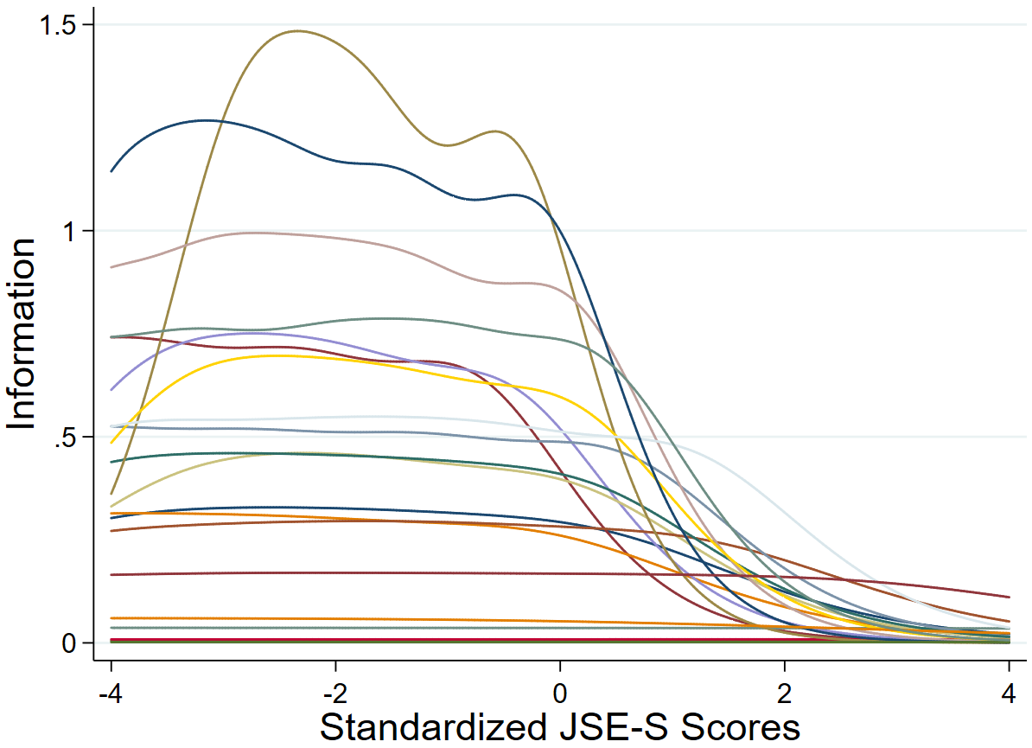
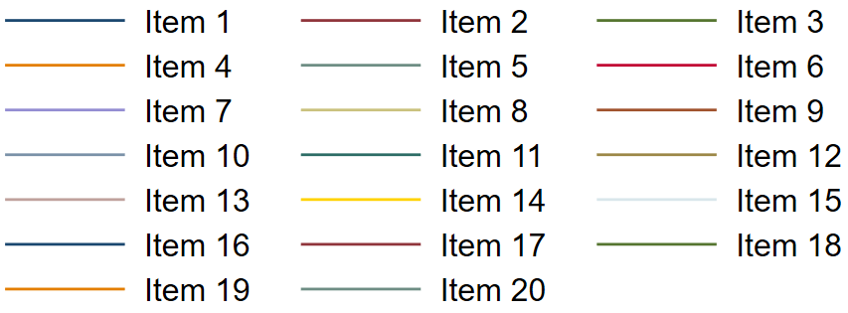
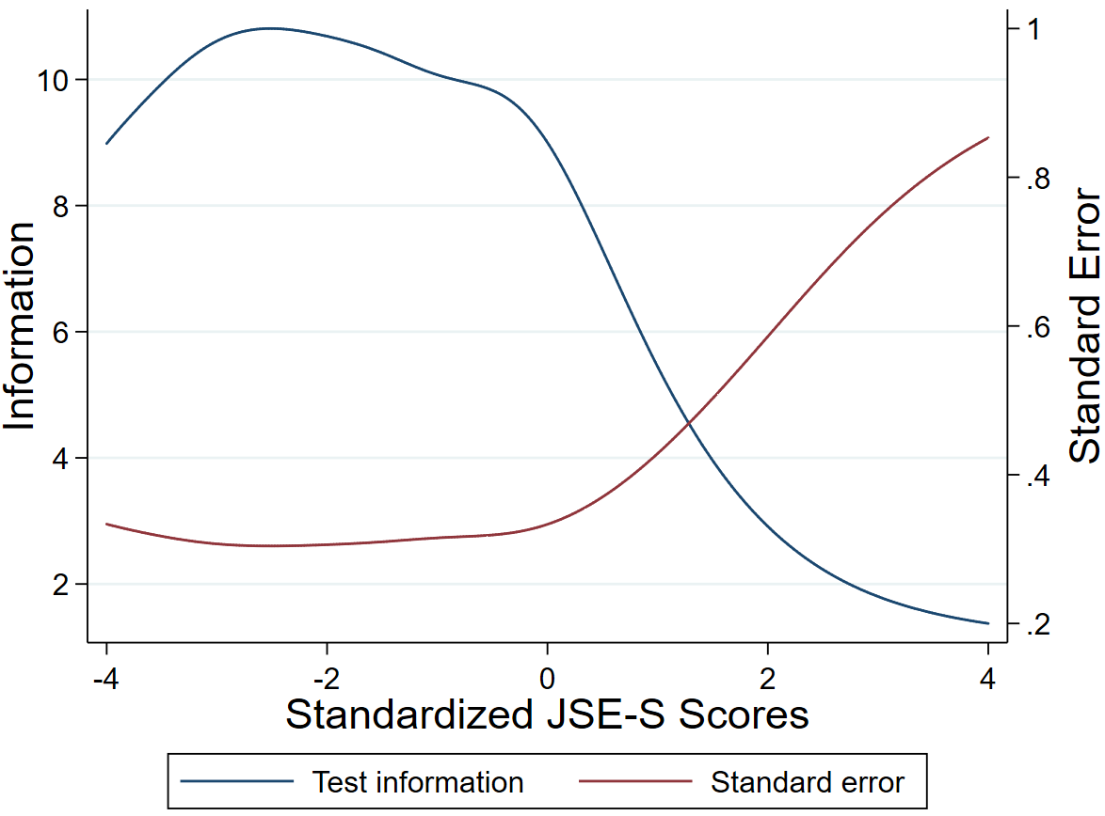
Item Response Theory Analysis of the Jefferson Scale of Empathy
(Student Version)
Giovanni Piumatti, Milena Abbiati, Anne Baroffio, Margaret W. Gerbase
Background and aim of the study
The Jefferson Scale of Empathy–Student version (JSE-S) is the most adopted self-reported tool in medical education research to assess empathy. This study tested the JSE-S using Item Response Theory analyses (IRT) to expand our knowledge on its psychometric characteristics and evidence if some items are more useful than others.
Summary of work
At the Geneva Medical School, 575 students (M_{age}=20.80 years, 64% females) enrolled to a pre-selection academic year filled in the JSE-S (females: M_{JSE-S}=113.85, SD=9.03; males: M_{JSE-S}=109.41, SD=10.54). Graded response modeling within IRT assessed JSE-S’ total scale reliability and tested single items’ performances in measuring medical students’ empathy levels.
Results
Figure 1. Item information graph for graded response IRT analysis of the JSE-S. Best performing items are indicated (N=575)
IRT estimated the discriminative power of each item, namely how well they differentiate between different levels of empathy. Although several items provided overlapping information (Fig. 1), the JES-S exhibited low standard error levels and high-test performance results especially at low levels of the empathy spectrum: when JES-S increases the standard error increases too (Fig. 2). Thus, the discriminative power of this scale diminishes when aiming to differentiate between students at high empathy levels.
Item 12
Item 16
Item 13
Table 1. The Jefferson Scale of Empathy – Student version (JSE-S)
Items (*Reverse scored items)
1. Physicians’ understanding of their patients’ feelings and the feelings of their patients’ families does not influence medical or surgical treatment*
2. Patients feel better when their physicians understand their feelings
3. It is difficult for a physician to view things from patients’ perspectives*
4. Understanding body language is as important as verbal communication in physician-patient relationships
5. A physician’s sense of humor contributes to a better clinical outcome
6. Because people are different, it is difficult to see things from patients’ perspectives*
7. Attention to patients’ emotions is not important in history taking*
8. Attentiveness to patients’ personal experiences does not influence treatment outcomes*
9. Physicians should try to stand in their patients’ shoes when providing care to them
10. Patients value a physician’s understanding of their feelings, which is therapeutic in its own right
11. Patients’ illnesses can be cured only by medical or surgical treatment; therefore, physicians’ emotional ties with their patients do not have a significant influence in medical or surgical treatment*
12. Asking patients about what is happening in their personal lives is not helpful in understanding their physical complaints*
13. Physicians should try to understand what is going on in their patients’ minds by paying attention to their non-verbal cues and body language
14. I believe that emotion has no place in the treatment of medical illness*
15. Empathy is a therapeutic skill without which the physician’s success is limited
16. Physicians’ understanding of the emotional status of their patients, as well as that of their families is one important component of the physician-patient relationship
17. Physicians should try to think like their patients in order to render better care
18. Physicians should not allow themselves to be influenced by strong personal bonds between their patients and their family members*
19. I do not enjoy reading non-medical literature or the arts*
20. I believe that empathy is an important therapeutic factor in medical treatment
Figure 2. Information graph showing JSE-S’ test information function and conditional standard error curve (N=575)
Most discriminative items at low empathy (=easier to agree with)
Most discriminative items at high empathy (=harder to agree with)
Main conclusions
The JSE-S is a reliable tool to assess medical students’ empathy, with low standard error and high-test performance.
It better differentiates between students at low rather than at high empathy levels.
Certain (but few) JSE-S’ items are particularly suited for tapping into high levels of the empathy spectrum.
Contact: giovanni.piumatti@unige.ch

